Slide 1
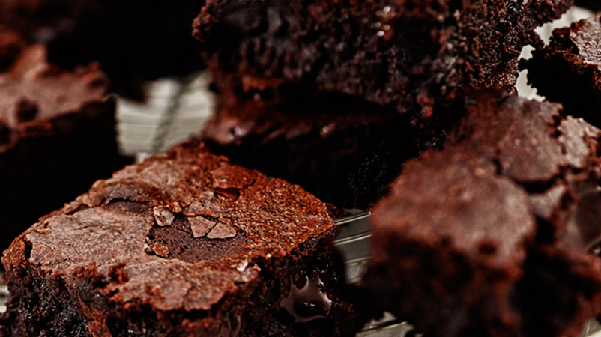
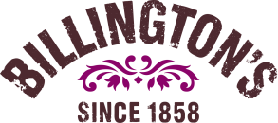
Billington’s MSS Meeting
Billington’s Introduction

Slide 2
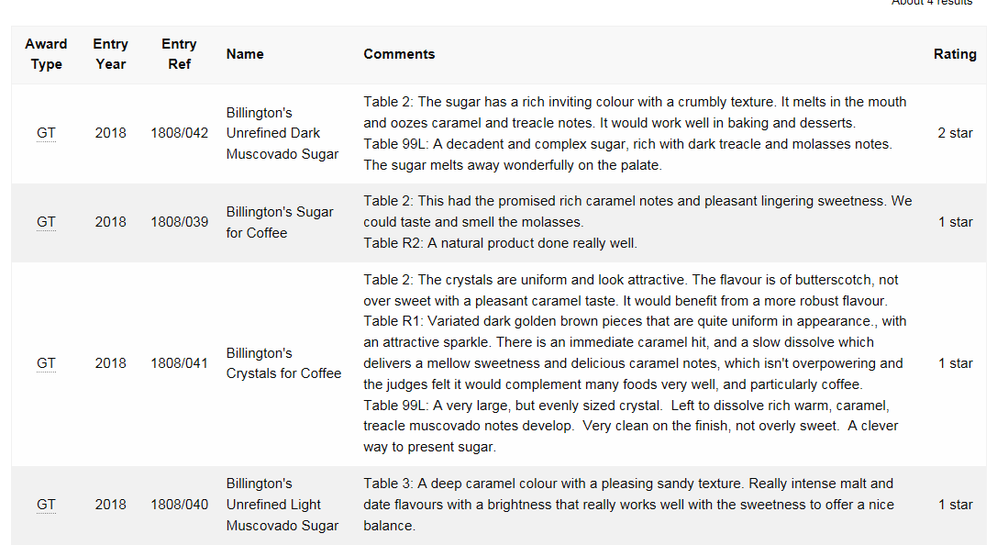
2018 Great Taste Award Winners
The Great Taste Awards are judged by a panel of 144 foodie experts with the most discerning palates, from chefs to food critics to restauranteurs to buyers and retailers.
What makes these awards so special is the products are all blind-tasted with a view to finding the most exquisite tasting food and drink.
As such they are recognised as a stamp of excellence by consumers and in turn help to influence purchase decisions.
Plus more sugars submitted for 2021

Slide 3
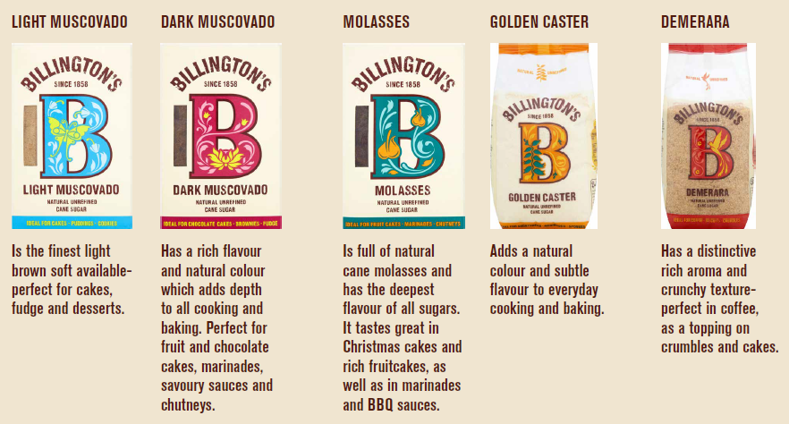
What We Say

Slide 4
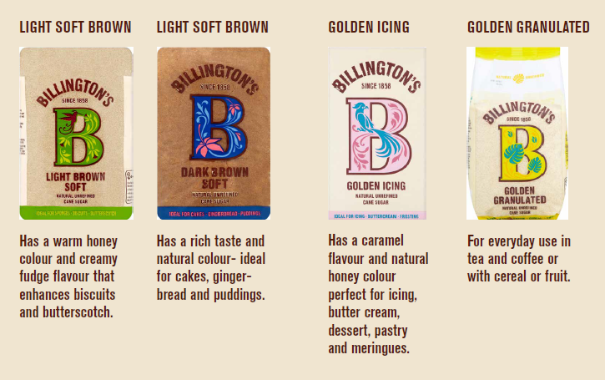
What We Say

Slide 5
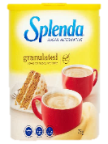
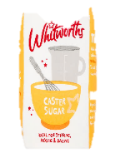
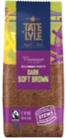
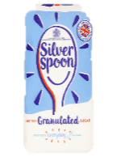
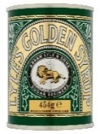
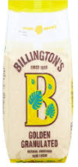
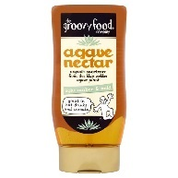
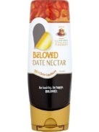
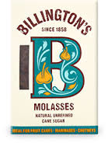
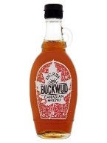
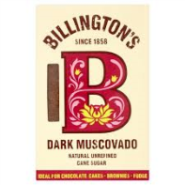
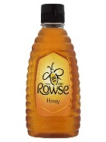
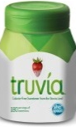
And our consumers understand Billington’s to be rich with equity…
Ranking sweetening products from artificial to natural
Candarel Red
Splenda
Stevia sweetener eg Truvia
White baking sugar
Refined brown sugar
White gran sugar
Golden syrup
Golden gran sugar
Agave nectar
Date nectar
Demerara
Molasses
Maple syrup
Unrefined brown sugar
Honey
Artificial
Natural
Top associations
Well known / trusted
Suitable for a wide range of uses
Enhance the flavour of what it's added to
142
Best quality available
Made with finest ingredients
Not overly processed
110
121
TNS Awareness Survey 1250 Online Respondents
Incite / Silver Spoon U&A 2016
Notes:
Billington’s is a brand rich with equity that our consumers truly understand…
We asked consumers to rank a whole range of sweetening products from artificial to natural and you can see here that our unrefined sugar is seen as being the 2nd most natural sweetening product you can buy.
Consumers tell us they can taste the difference with our sugars verses our competitor set
And they see us as being the best quality available.
These 3 equities are constantly played back to us by consumers whenever we talk to them

