Slide 2
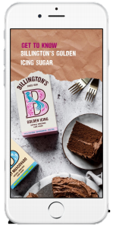
Billingtons Social Media
@BillingtonsUK
Younger foodie audience
10,561 followers
105k organic reach
@BillingtonsSugar
Older foodie audience
1,122 followers
16.5k organic reach

Slide 3
Different Ways We Can Work Together
Stories
Highlights
Grid Posts
Competitions

Slide 4
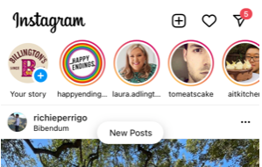
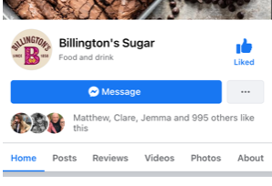
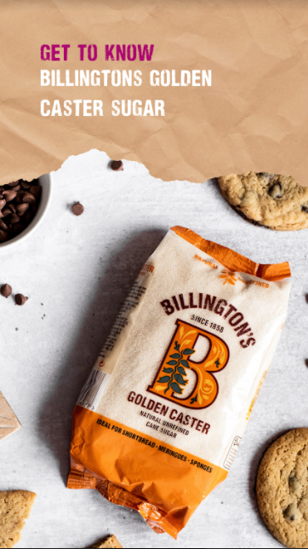
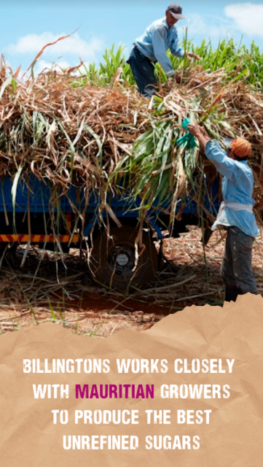
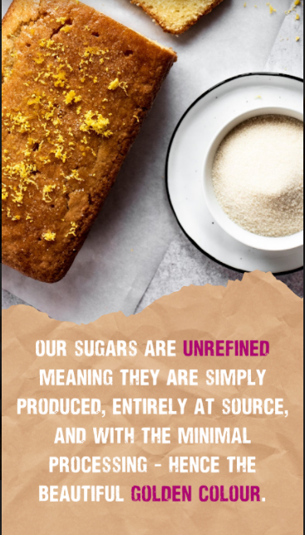
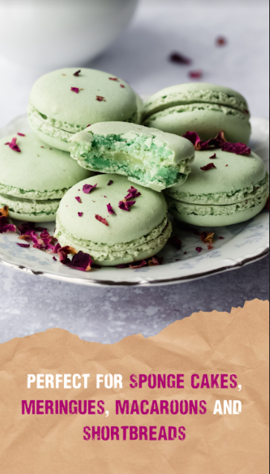
Stories
Each month, Billington’s champions a ‘sugar of the month’ and posts about it on our social media channels
Billington’s can tag MSS in stories about Mauritius and the process of making special sugars
MSS can reshare the content they are tagged in, and tag us in their posts if they wish

Slide 5
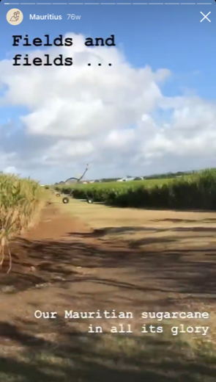
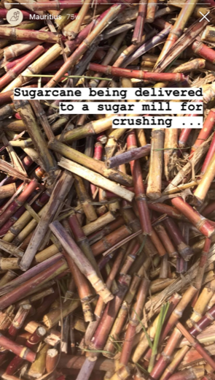
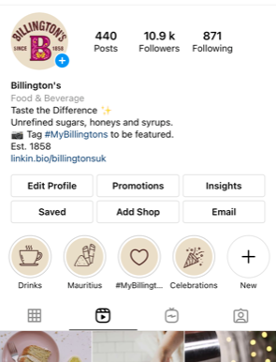
Highlights
On our next visit, any content we shoot will likely be shared on stories, which are live 24hr. These can then be saved down and categorised into highlights. We can use these posts to share more information about Billington’s and MSS

Slide 6
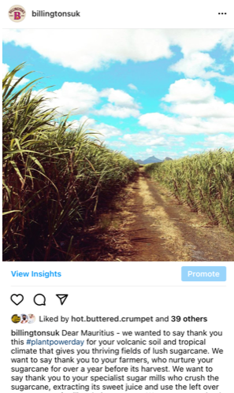
Grid Posts
Billington’s can tag MSS in grid posts about Mauritius and the process of making special sugars
MSS can;
Reshare these tagged posts,
Comments on the posts to drive engagement and click through
Tag images to their own grid and tag Billington’s

Slide 7
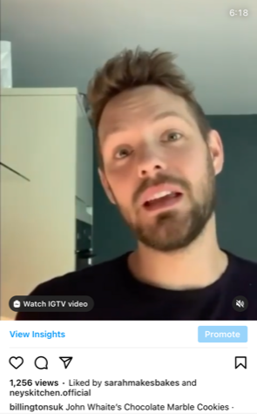
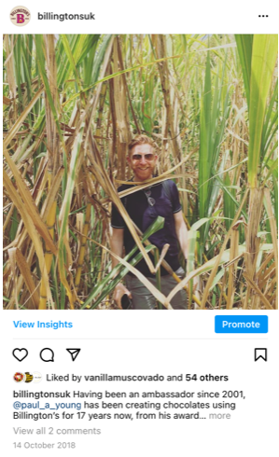
Grid Posts
Where relevant, we could include MSS in the posts where our influencers talk about our sugar, or about Mauritus,

Slide 8
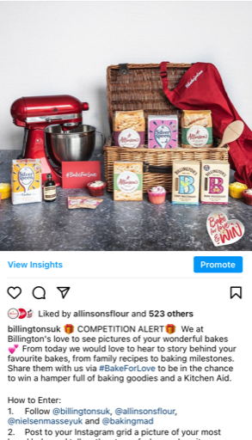
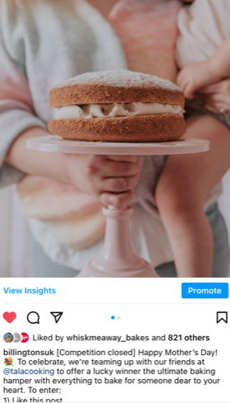
Competitions
Budget allowing, Billingtons and MSS could look at running a social media competition, to gain followers and awareness of the brands.
Typically we would run a competition over a couple of weeks.
The prizes need to be relevant, and attractive to the audience, but also not so large that they feel unattainable.
This works best where we have a similar audience that we wold like to share & grow.

