Slide 1
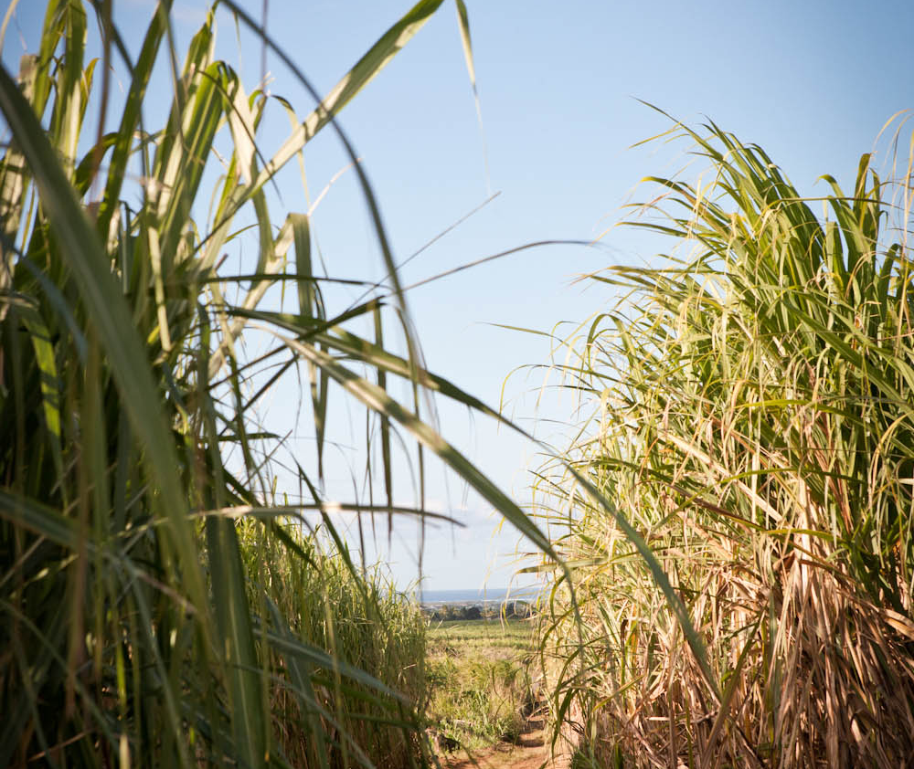
What is a Sugar Cane?
Part of the Poaceae family, the saccharum plant is a tall grass that grows up to 5 meters tall
The mature stalk has the typical composition of;
Water 70%
Sugar 16%
Fibre 11%
Other 3%
It grows exclusively in tropical or subtropical climates
Makes up roughly 80% of global sugar production

Slide 2
The History of Cane in Mauritius
Sugar cane has been grown and turned into the sweet stuff for almost 400 years – first introduced onto Mauritius by the Dutch in around 1638, when they returned to colonise the island after accidentally discovering it in 1598. (the first to set foot on the island were the Arabs (around 900 AD) followed by the Portuguese early in the 1500’s who named the island Ilha do Cirne, Swan Island)
Importing sugar cane from Java and a workforce of slaves from Mozambique and Madagascar, the intention was to produce Arak – a potent rum popular among sailors.
After the Dutch left in 1710, pushed out by unbearable heat and cyclones, the French took over, continuing the transportation and exploitation to produce sugar for their king.
When Britain arrived to occupy the island in 1810 (after the Slave Trade Act of 1807 but before the 1833 Slavery Abolition Act), it resulted in a boom in the nation’s sugar industry.
As navigation laws were repealed and abolished, Mauritian sugar was able to be sold in other countries, competing with sugar from the West Indies, and around 400 Mauritian sugar factories were in operation.
Today, brick chimneys are bold reminders of the country’s industry, but as the industry and economy has boomed in other sectors, only three sugar factories remain o the island

Slide 3
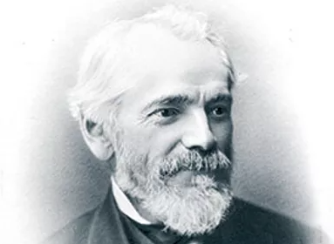
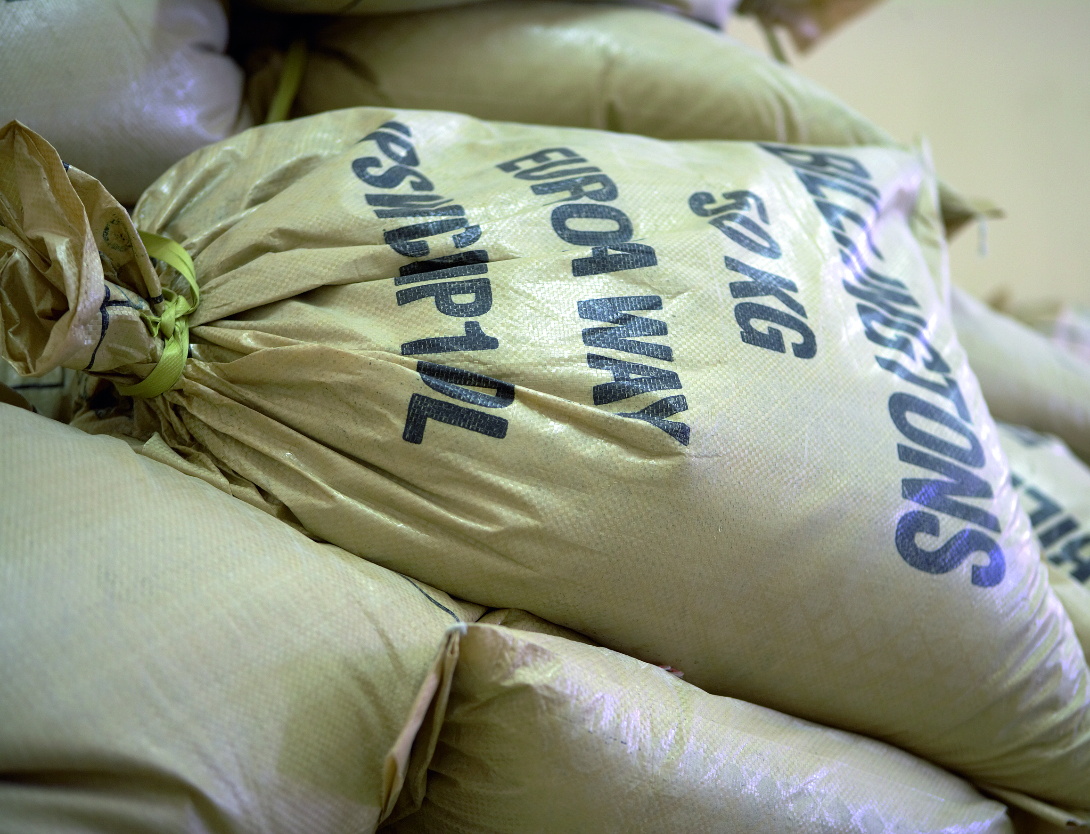
Billington’s Heritage
Edward Billington and Son began trading tea and coffee across the oceans in 1858 and started to import sugar soon after.
It was in 1977 that Billington’s began to import sugar of the highest quality – the Mauritian unrefined brown sugars for which we are famous today.
To the present day and Billington’s is now part of The Associated British Foods Group, joining The Silver Spoon Company in 2004.
Our founding values of quality, integrity and fair trading, as well as our rich family heritage are still absolutely central to the way we do business today.

Slide 4
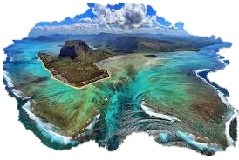
Unrefined Sugar Sourced from the Best Location
Sugar cane grows exclusively in the tropical & sub tropical zones. Perfect climate for growth.
MSS are the sole sugar marketing organisation in Mauritius & responsible for the marketing, governance & export of all sugar in Mauritius.
Mauritius’ annual sugar crop creates 300kt of sugar, of which almost half is kept unrefined.
MSS are 100 years old and a ‘not for profit’ organisation. Anyone involved in the sugar cane Industry is a member
MSS have developed a high sense of CSR, cultivating & processing sugar cane with minimal impact on the environment, improving processes, skills & livelihoods of people in the community.
Together we pioneered the visionary idea of value added at source & has evolved into a business model for the production of sustainable sugar

Slide 5
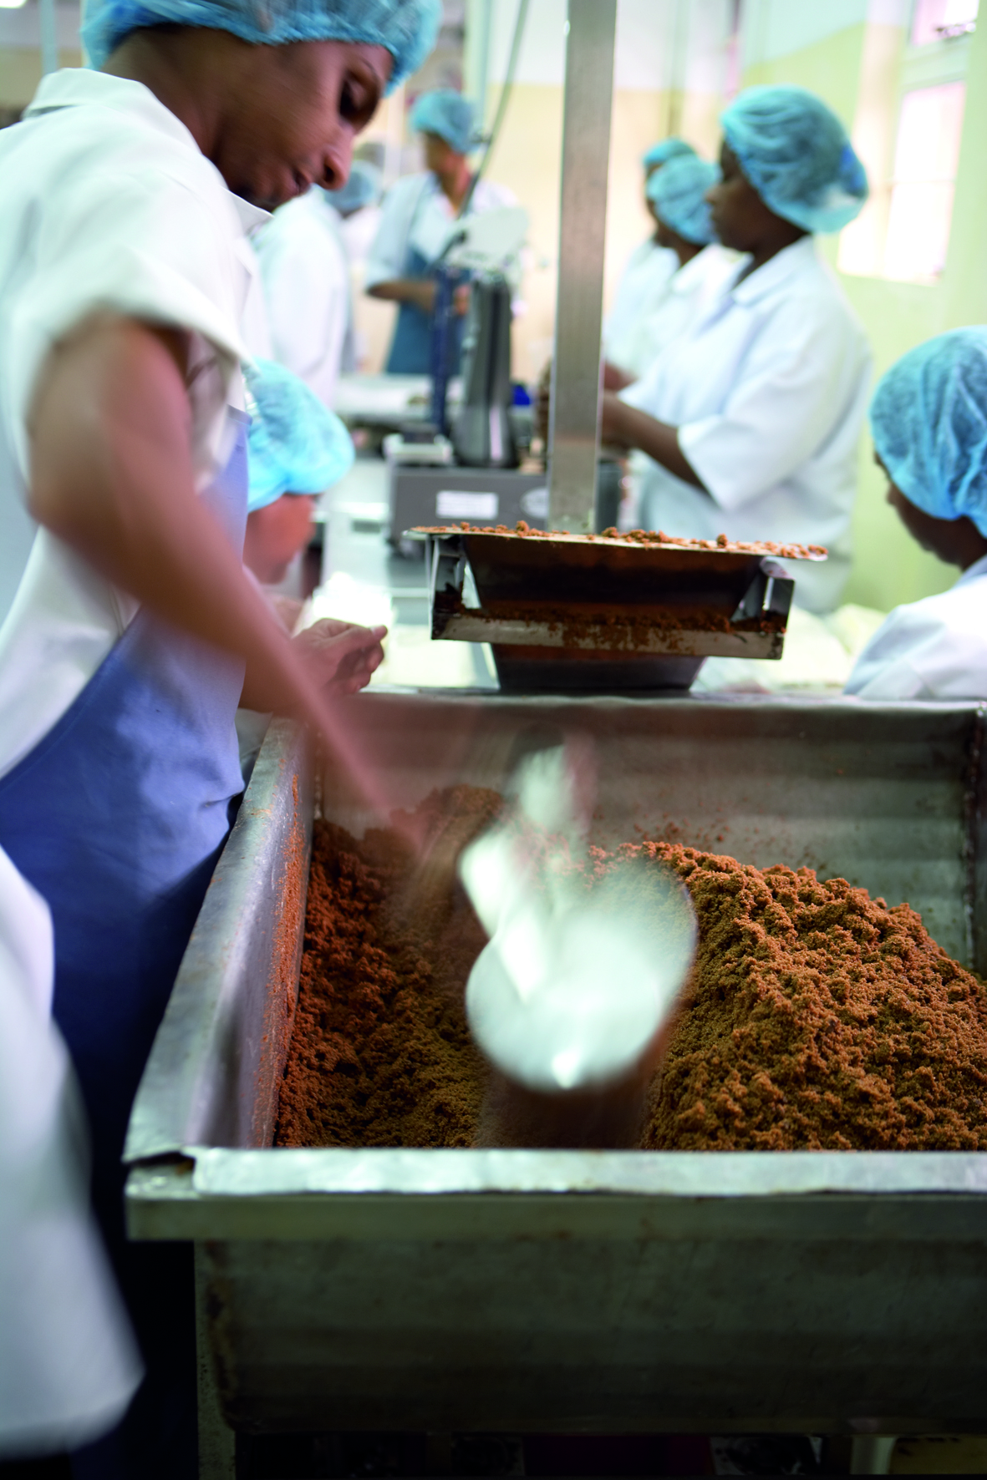
Crafting our Unrefined Sugars
Billington’s unrefined sugar is made by doing very little to it.. Which is actually a lot harder to do. But by keeping Billington’s as close to its natural state as possible, it gives your kitchen creations a richer, more delicious flavour.
We craft our sugars with precision, time and care. The skill is in stopping the process at exactly the right moment, to create the many different types, flavours and colours that make up our full spectrum of sugar
This practice is designed to lock in, rather than refine out the natural molasses. It is this difference that gives unrefined sugar its superior flavour and natural colour.
Notes:
Mauritius’ annual sugar crop creates 325kt of sugar, of which over a third are kept unrefined.

Slide 6
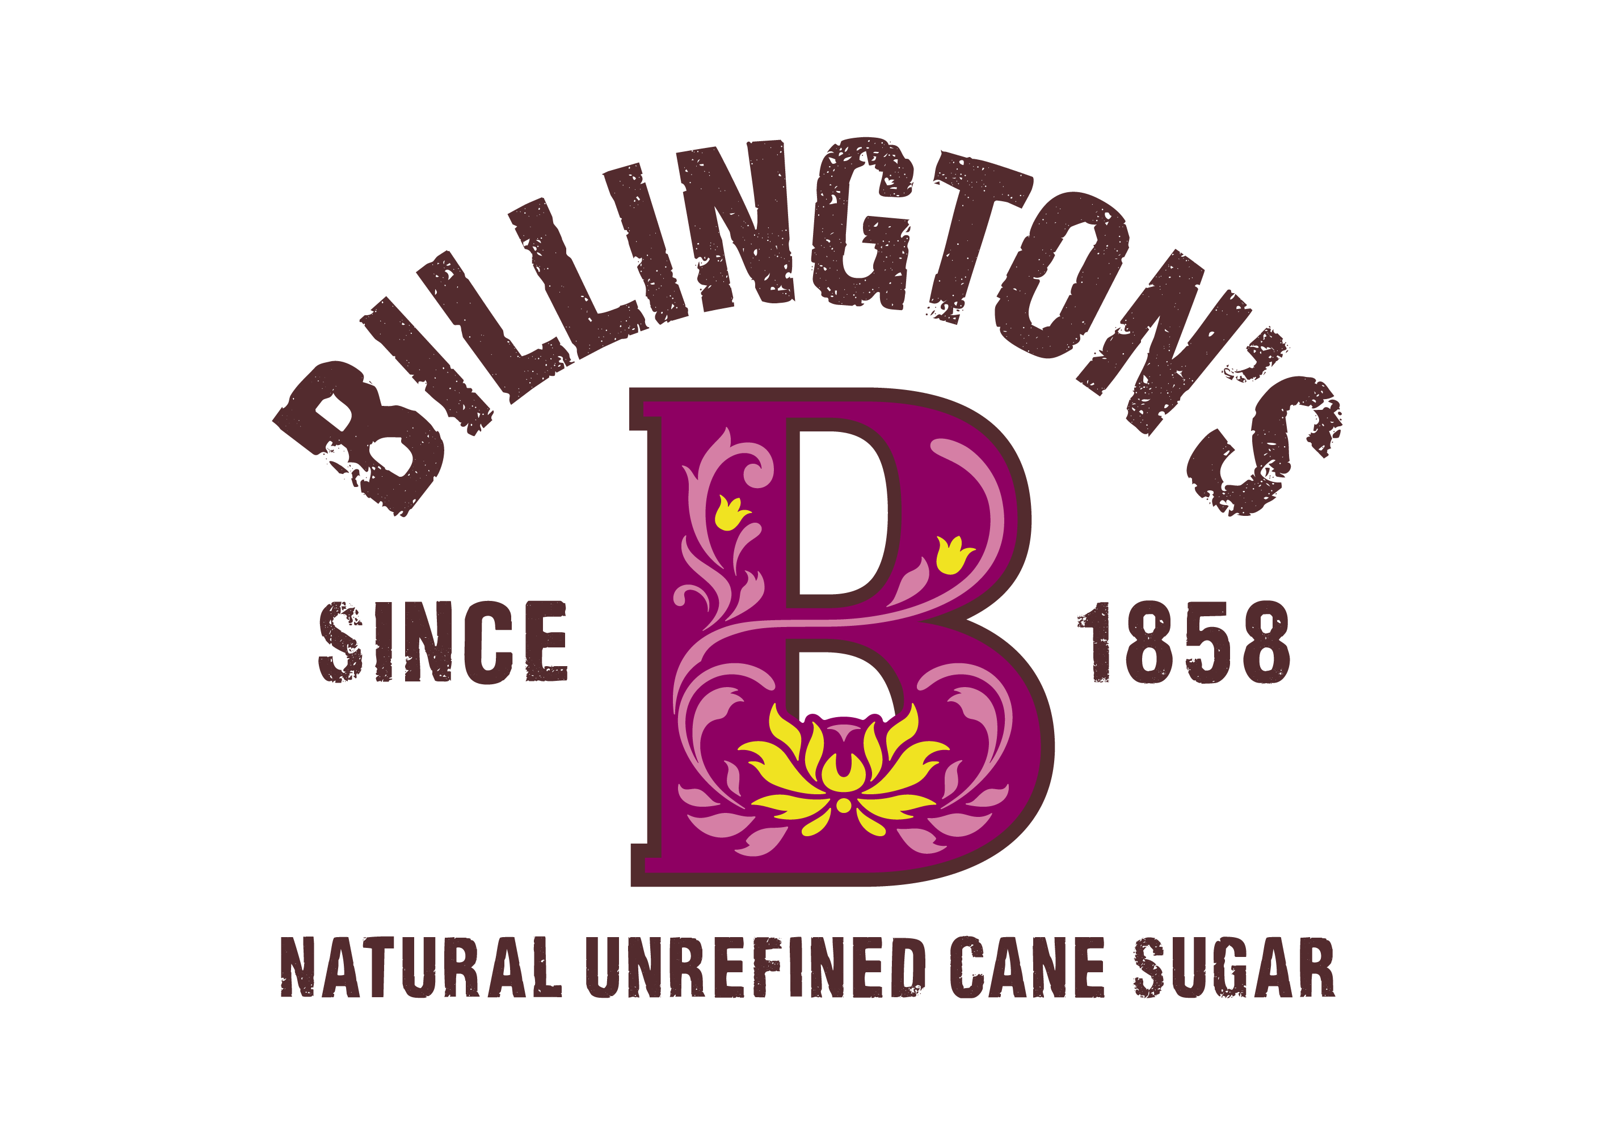
Developing the Sustainable Cane Chain
People & Communities
Unrefined Sugars
Virtually Zero Waste
Sustainable Packaging
Produced at source in Mauritius
Ensured equitable returns throughout supply chain
Simply and minimally processed
Locking in, rather than refining out, the natural molasses
Steam, water and by-products are reused by the mills to power the factory
Signatories of the plastic pact
Plans to move plastics to recyclable monofilm
Notes:
Mauritian sourced – fairly traded
Zero waste
Simple process with minimal refining
Packaging

Slide 7
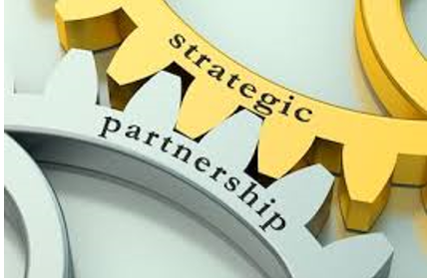
Our Mauritian Partners Ensure Equitable Returns Throughout the Supply Chain
100 yrs old
TRUSTED GOVERNANCE
Responsible for all marketing & export of all the sugar produced
Collects the proceeds of sales & fairly distributes to its 10,500 producers
Governed by a committee comprising of corporate & independent sugar cane growers & millers
Work to a global sustainability standard aligning all sectors of it’s value chain inc special initiatives for small planters
PARTNERSHIP
Long standing relationship since the 1970’s
Mills & MSS are working together to develop a future-proofed sourcing model that has a measurable sustainability agenda
Together we developed the market for unrefined, direct consumption sugar products was developed jointly, with focus on:
Quality, Taste & Performance
Pioneering the idea of value being added at source

Slide 8
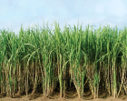
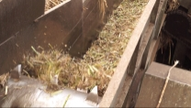
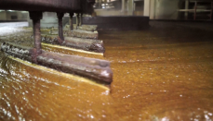
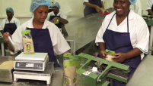
Process of making sugar from cane
Sugar Cane is Grown in Mauritius
Billington’s unrefined sugar
All parts of the plant are used, and nothing is wasted
Steam from bagasse-fired power plant is used for sugar juice evaporation
Vapour from evaporators becomes source of processing steam for the mill
Condensation from evaporators recycled into power
Water from extraction process recycled and reused
Molasses by-product for ethanol and rum
Surplus electricity is exported to the national grid
Cane contains up to 70% water which is released during production process reducing the factories reliance on external sources
Cane juice is extracted
The juice is clarified
Then evaporated and crystalised
And packed
Notes:
The Process
SUGAR CANE Grown in Mauritius
Cane is EXTRACTED (shredded, pressed & boiled to remove juice)
Juice is CLARIFIED (insoluble matter is removed & filtered)
EVAPORATION & CRYSTALLISATION SEPARATION (separates crystals & excess molasses in centrifuge)
Sugar is PACKED
By product: Bagasse (cane fibre)
dried out and used as boiler fuel to power process and create electricity
Bagasse sees Carbon Neutral production
Clean and Renewable
Replacing Fossil Fuel
Reducing CO2 emissions
Some of the country’s power comes from Bagasse

