Slide 1



Taking
Mauritius Sugars
to greater heights

Slide 2
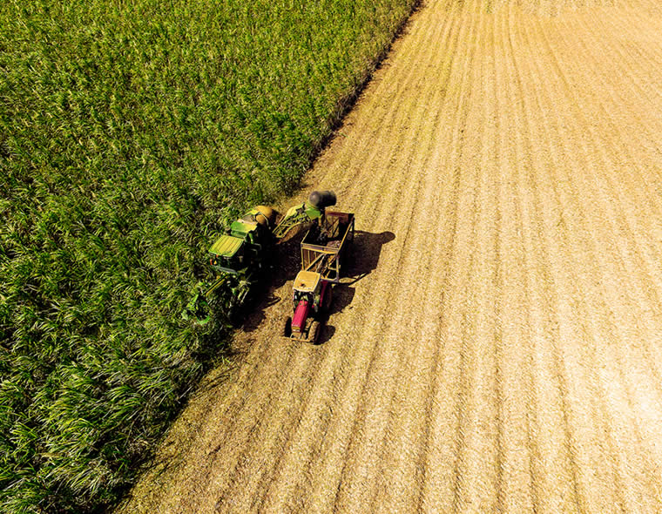

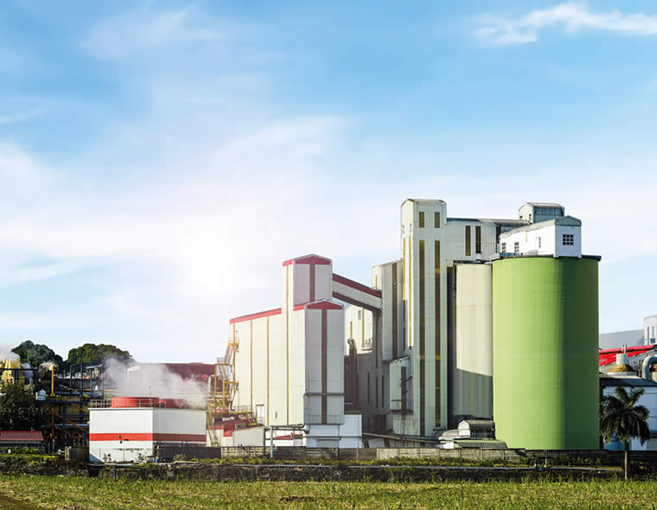
Structure of Industry
Growing Sector
Growing Companies
(20)
Service Providers
Sugar Cane Planters
(10,482)
Milling sector
(3 millers)
Individual Planters
(5,800)
Supplier of Consumables
Cooperatives
(150)

Slide 3
Structure of Industry
MSS as interface between Producers and Market
Producers
Ex-Syndicate Price
Sugar
MSS
Marketing
Export
Logistics
Compliance
Contracts
Proceeds
Market
Producers-led / commercial arm of industry
Non-profit organization : main goal to maximize net revenue of its members, i.e the producers, the growers and the planters through the highest selling prices for their sugars at the lowest delivery costs.

Slide 4
Emphasis on production and sales of higher value
Cane Special Sugars – target niche market segments

Slide 5
45%
Europe
4%
Middle
East
7%
6%
Americas
Asia
28%
Africa
AMERICAS
USA & CANADA
EUROPE
WESTERN & EASTERN EUROPE, THE BALKANS, SCANDINAVIA
AFRICA
SOUTH AFRICA, KENYA, MADAGASCAR, COMORES, MAYOTTE
ASIA
SINGAPORE, CHINA,
MALAYSIA, TAIWAN, KOREA
MIDDLE EAST
DUBAI, OMAN, SAUDI ARABIA, ISRAEL, KUWEIT
GLOBAL FOOTPRINT
SPECIAL SUGARS SOLD TO 120 CUSTOMERS ACROSS 55 COUNTRIES

Slide 6

What make Mauritius Sugars so special?

Slide 7


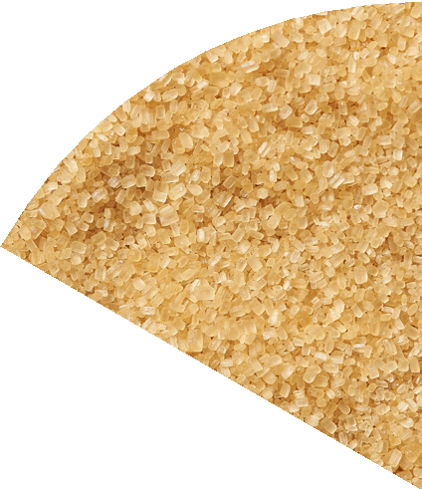


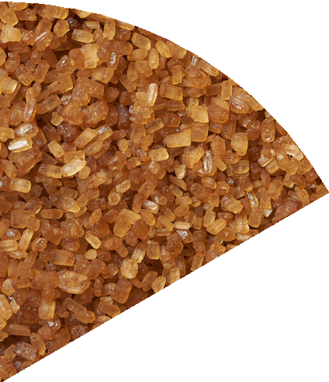
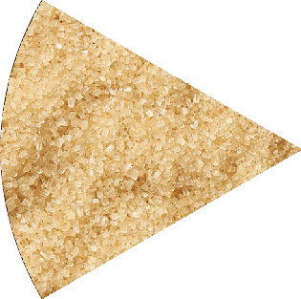
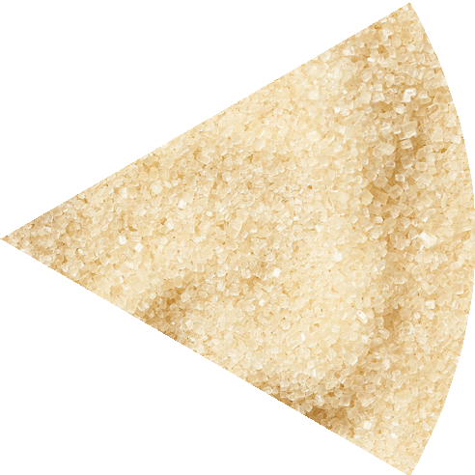
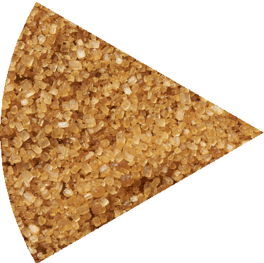
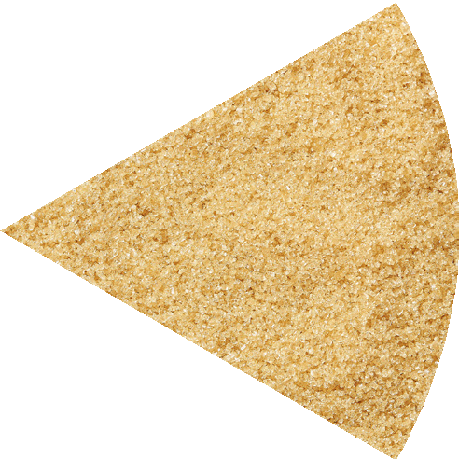
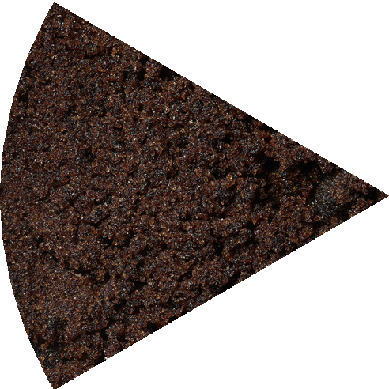
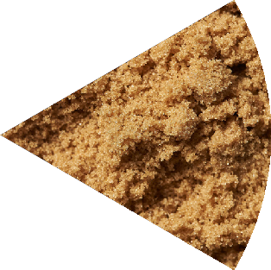

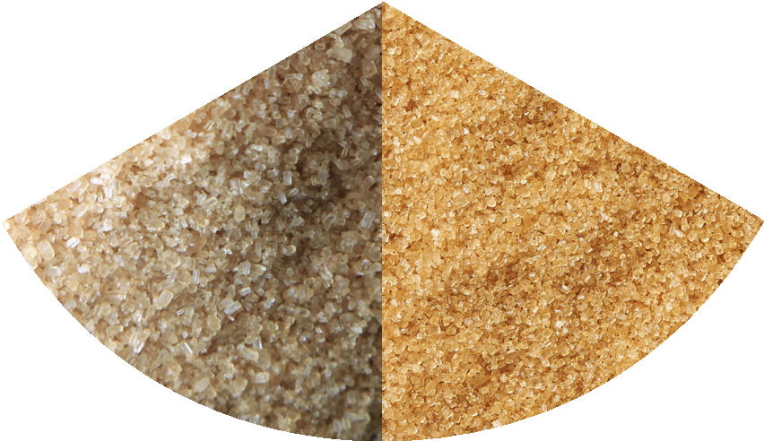

Special Sugars
Range of products - 18 varieties grouped into 3 main families
Natural Classics
Authentic Classics
Wholesome Gems
Fine Caster
Golden Caster
Dry Demerara
Clear Demerara
Extra light Muscovado
Coffee
Cystrals
Mauritius Industrial Cane Sugar
Golden Granulated
Dark Standard Demerara
Fine Demerara
Light Muscovado
Molasses
Golden Brown Granulated
Special Raw
Standard Demerara
Dark Demerara
Dark Muscovado
Dark Brown Soft
Choice
Quality
Consistency

Slide 8
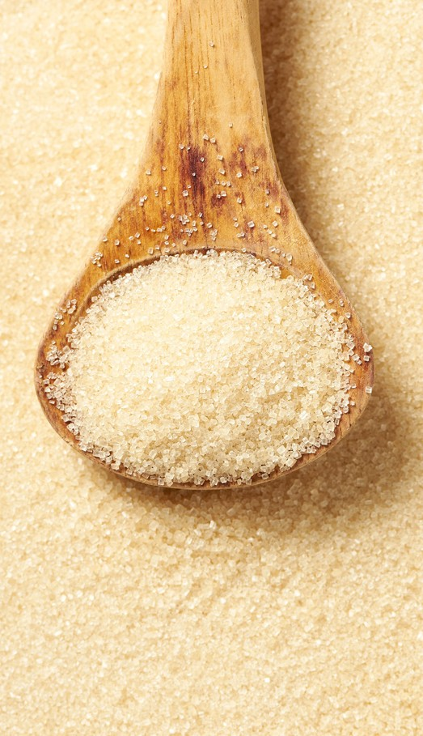
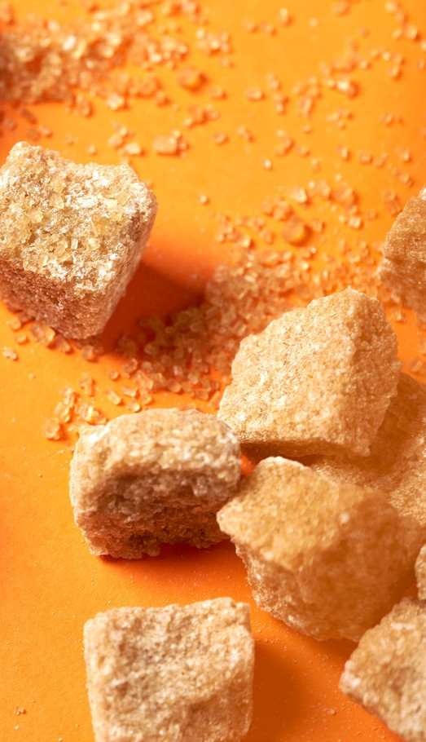


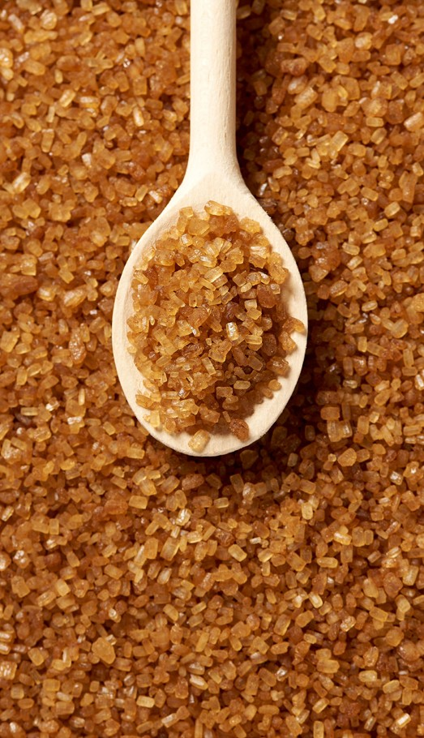
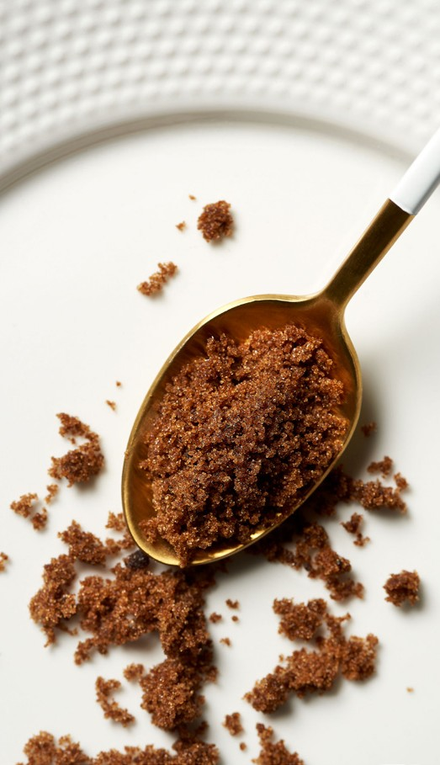
The core pillars of ‘Made in Mauritius’ Special Sugars
Wholesomeness
Taste
Healthy Benefits
Traceability
Sustainability
Easy & Convenient Sourcing

Slide 9


1. Wholesome - Natural
Minimally processed, yet food safe
Control over process parameters by vastly experienced engineers
No artificial flavouring or colouring
Absence of additives
Non-GMO
Not subject to ionizing radiation

Slide 10
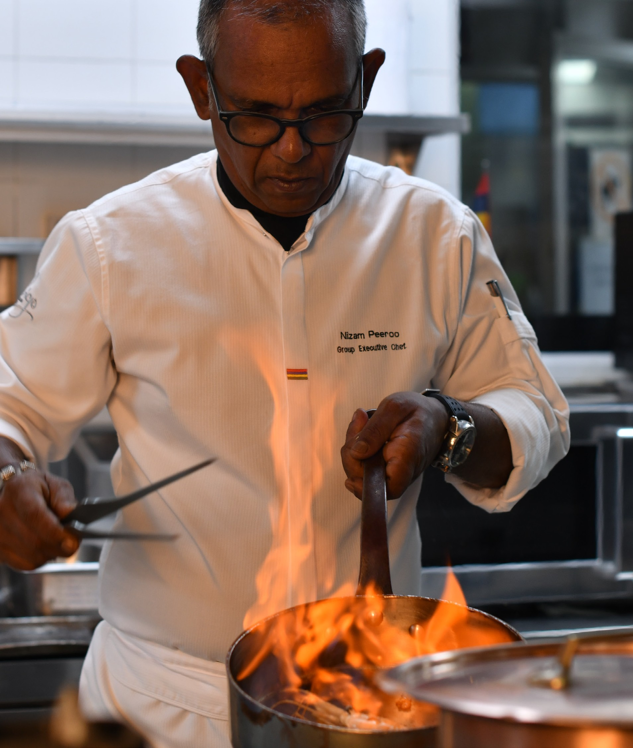
2. Taste
Preserve natural taste of cane juice
Great taste award winners
Renowned across the globe for natural intensity of their aroma and flavor
Versatility of usage

Slide 11

3. Healthy
Rich in minerals, vitamin, anti-oxydant
Low GI sugar to suit diabetics

Slide 12

Healthy: Rich in Oligo
Elements + Gluten free + Allergen Free
Mineral | Reference Daily intake | White Sugar | Molasses Sugar | Dark Muscovado | Light Muscovado | Dark Standard Demerara
Calcium mg/100g | 1000 | 0.018 | 10.95 | 6.85 | 4.53 | 1.66
Iron mg/100g | 18 | <0.083 | 11.72 | 6.64 | 2.58 | 1.03
Potassium mg/100g | 3500 | 0 | 12.57 | 8.80 | 4.76 | 1.35
Magnesium mg/100g | 400 | n/p | 12.56 | 7.79 | 4.36 | 1.33
Manganese mg/100g | 2.0 | n/p | 25.00 | 14.75 | 7.25 | 2.18

Slide 13
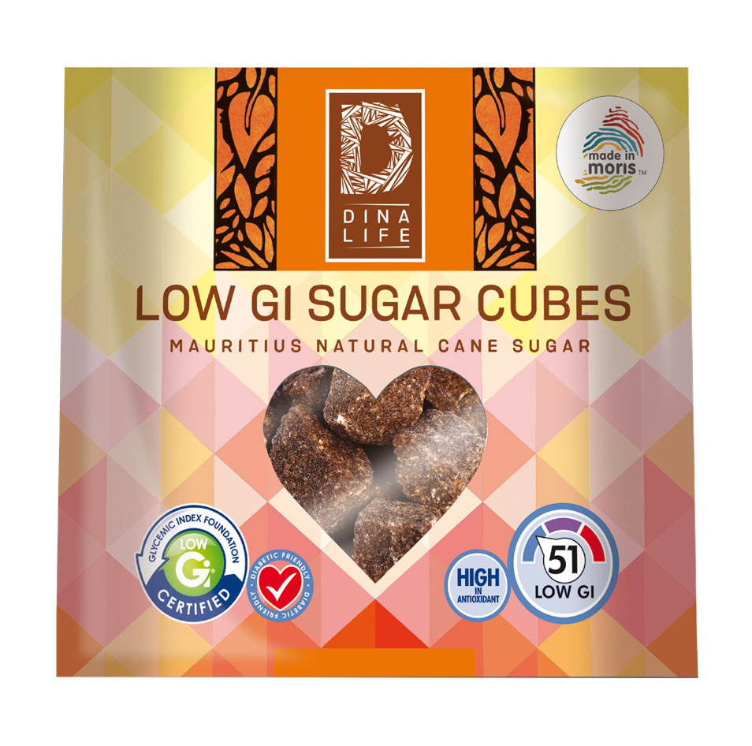

Healthy: Rich in Oligo
Innovation - LOW G.I & ANTIOXIDANT SUGAR CUBES
One of a new generation of natural sugars, , diabetic friendly, developed through extensive research and innovation by Omnicane
Contains antioxidants which stimulate the immune system, enhance the natural tone and firmness of the skin, lower bad cholesterol , protect the liver and heart and minimise the effect of the ageing process.

Slide 14


4. Traceability
Traceable at all stages of production – through production batch codes
Rigorous quality & food safety standards at sugar mills
Food safety accreditation

Slide 15
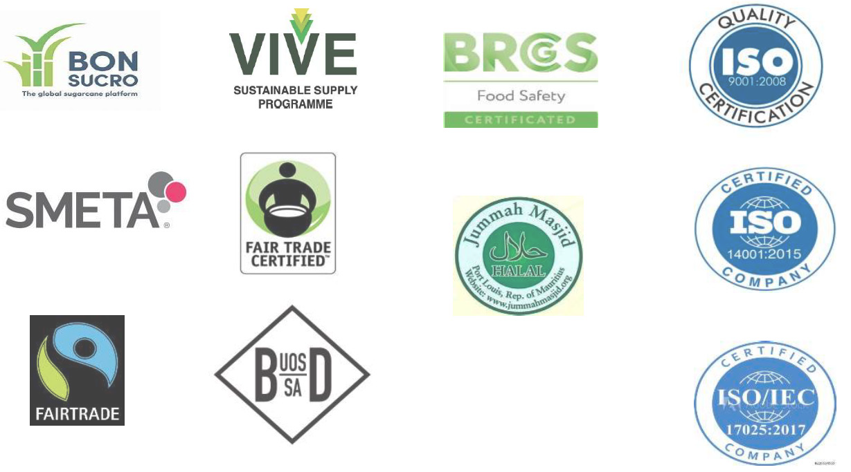
Accreditation for Quality & Sustainability
MSS has been actively ensuring rigorous quality and food safety standards

Slide 16
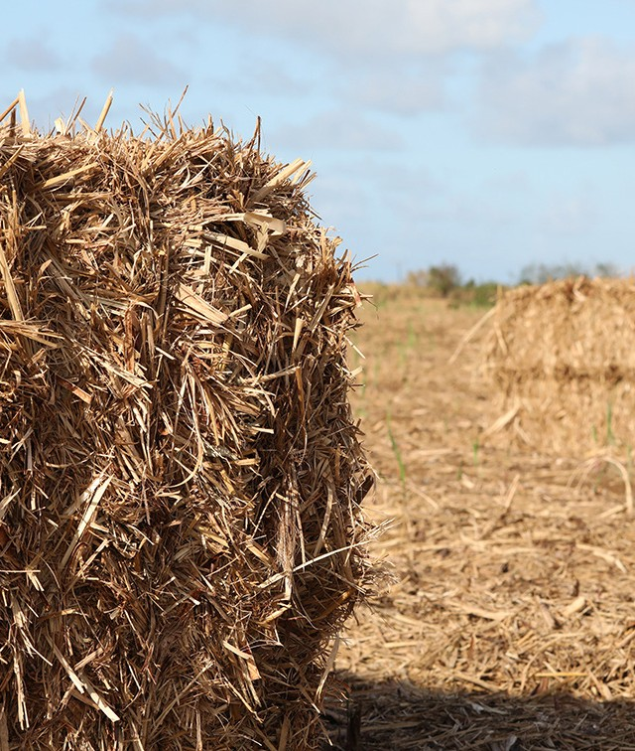
5. Sustainability
Eco Friendly circular economy Low Carbon Foot print
Fairtrade label
Eco friendly packaging

Slide 17








Our eco-friendly Circular Business
Reduce, Re-produce, Re-use, Recycle
SUGAR MILLING
SUGAR REFINING
SUGAR
ORGANIC CANE RESIDUE
FINISHED PRODUCT
CANE JUICE MOLASSES
SUGAR CANE
SUGAR CANE FIELDS
DISTILLERY & SPIRITS
SUGAR CANE
ORGANIC FERTILISER
BAGASSE
BRAND
STEAM & ELECTRICITY
FOR CONSTRUCTIONS USE
CEMENT ADDITIVES,
•ROCKSAND AND
•BLOCKS
BAGASSE ASHES
POWER PLANT
PROPERTY
CONSTRUCTION
ALCOHOL
SUGARCANE TRASH
POWER PLANT
COAL ASHES
NATIONAL GRID ENERGY
PRODUCTION

Slide 18
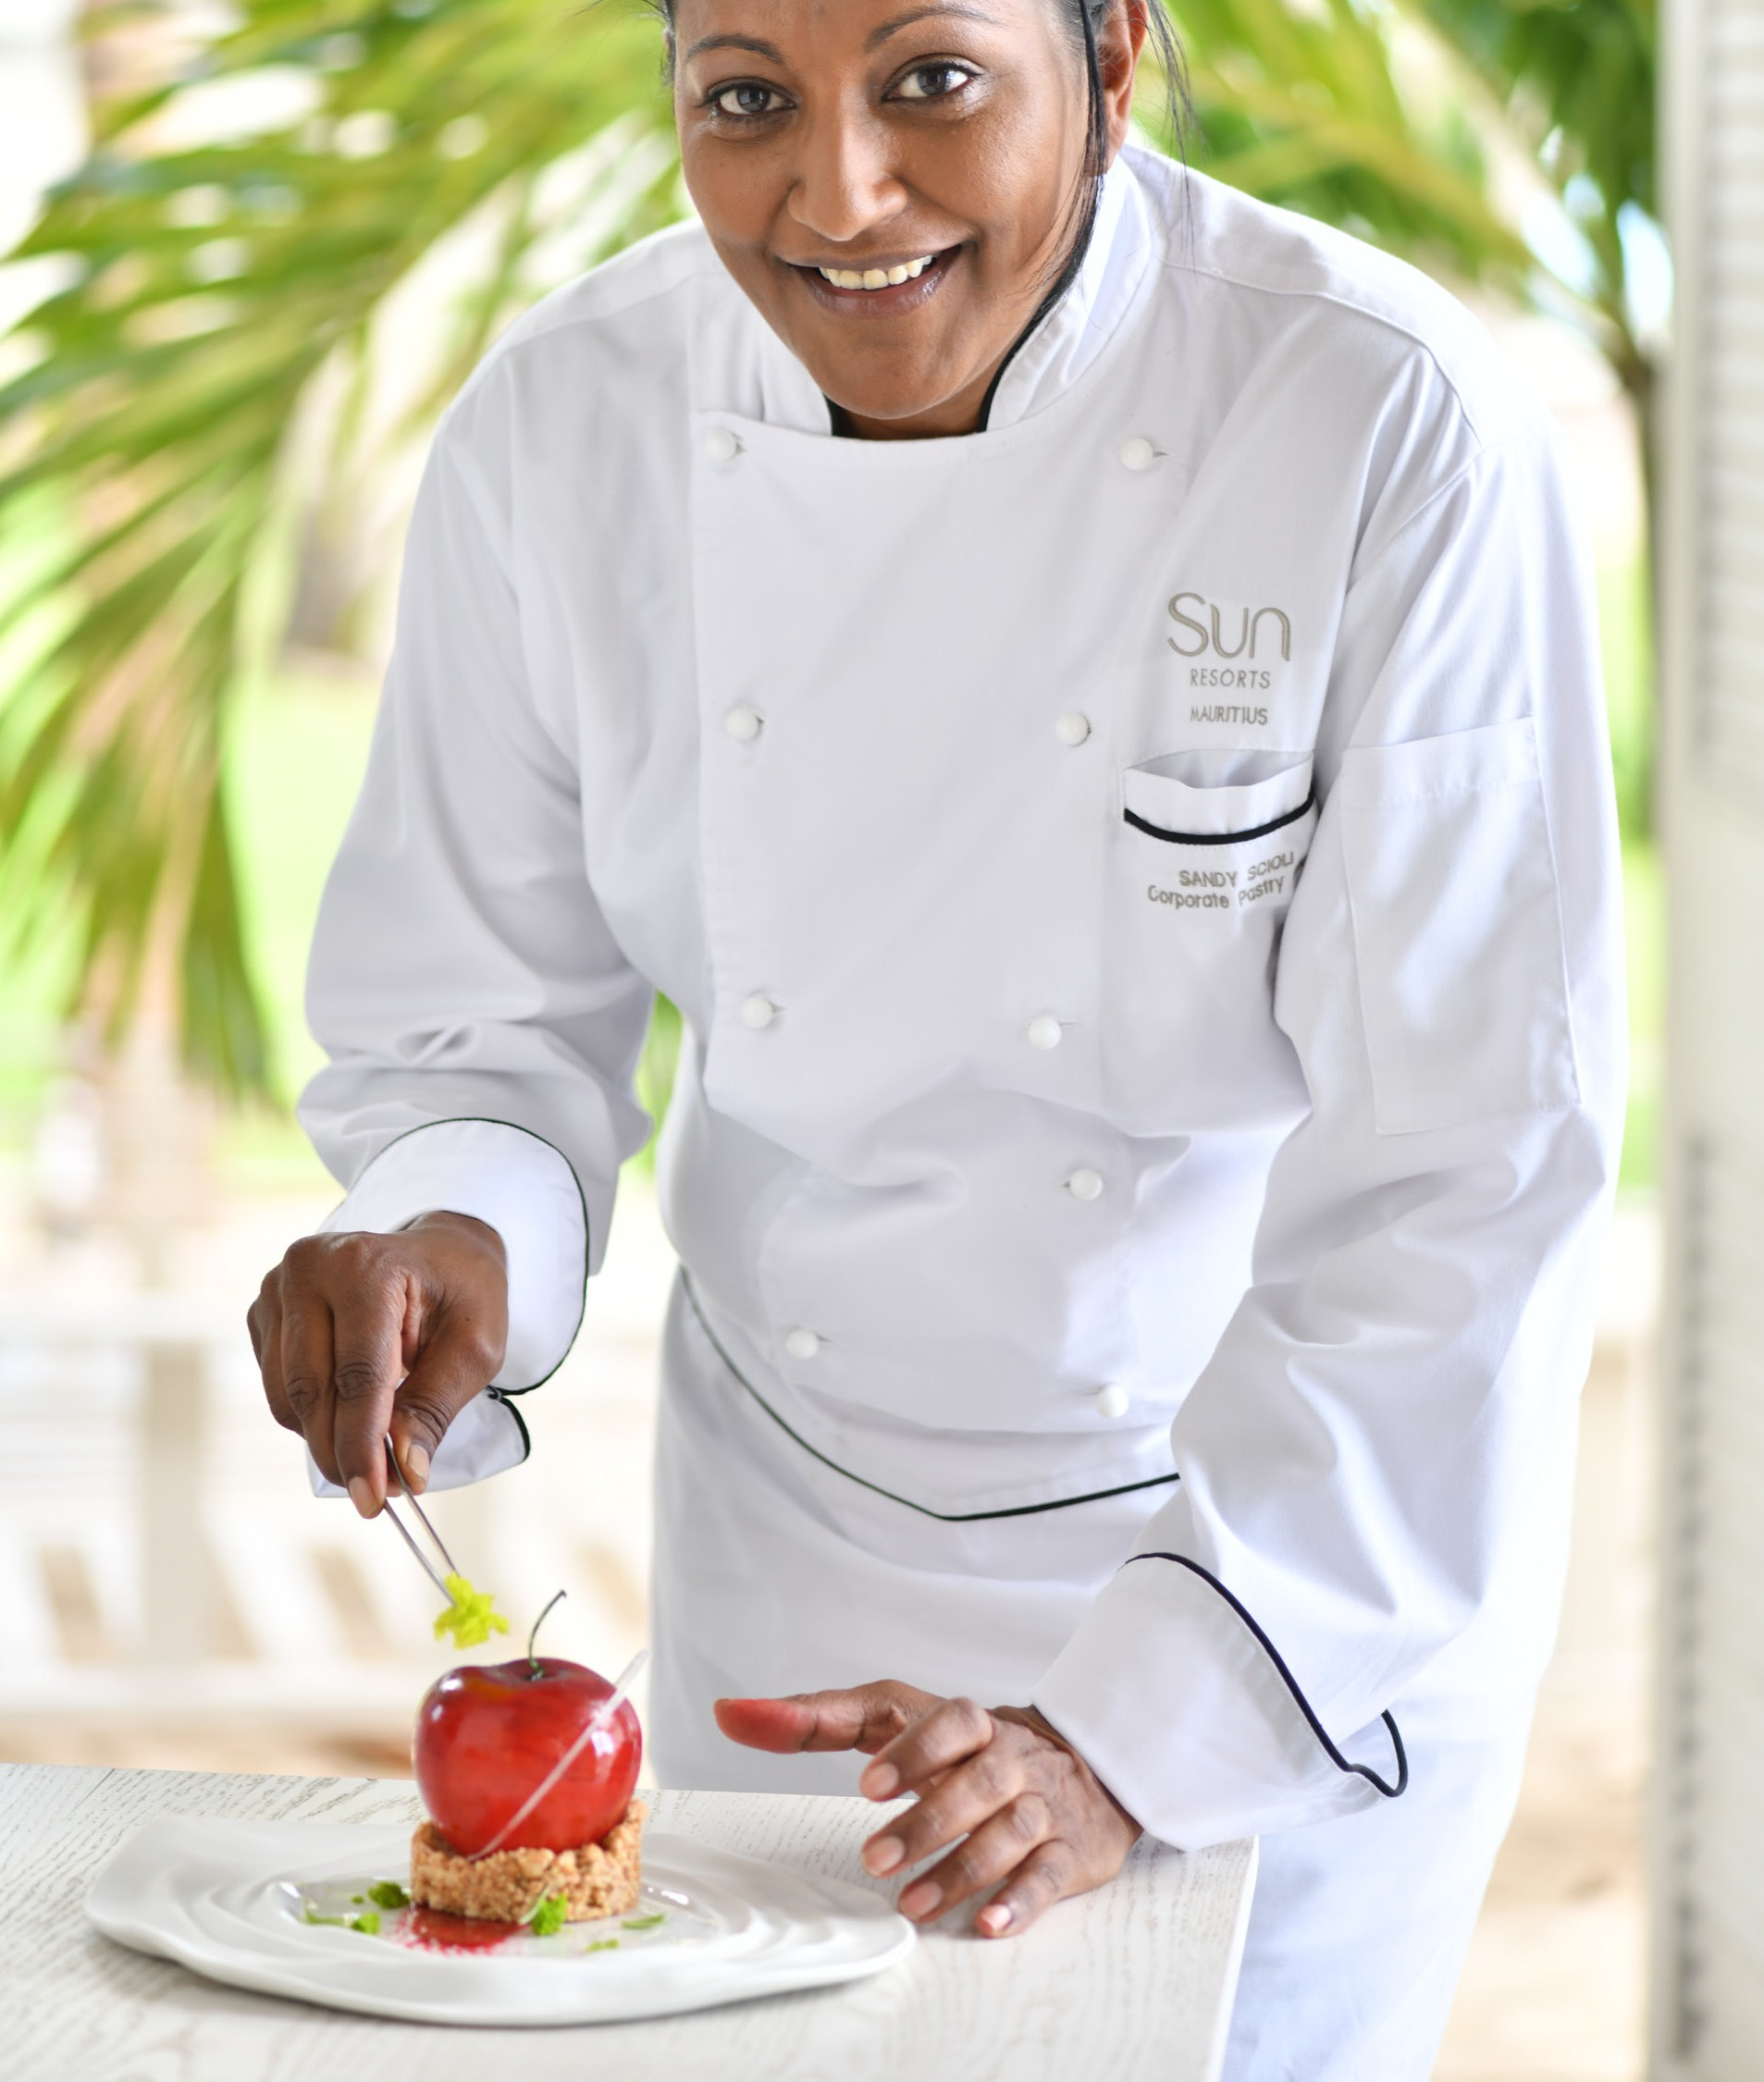
6. Easy and Convenient Sourcing
One stop shop
Responsive customer service
Secured supply chain making it risk free
Passion for customer satisfaction
Customer loyalty and long-term partnership

Slide 19



































Our Trusted Clients

Slide 20

Thank you
www.mauritiussugar.mu
For queries, please contact:
Devesh Dukhira - ddukhira@mauritiussugar.mu
Sebastien Giraud - sgiraud@mauritiussugar.mu
Thank you

