Slide 1
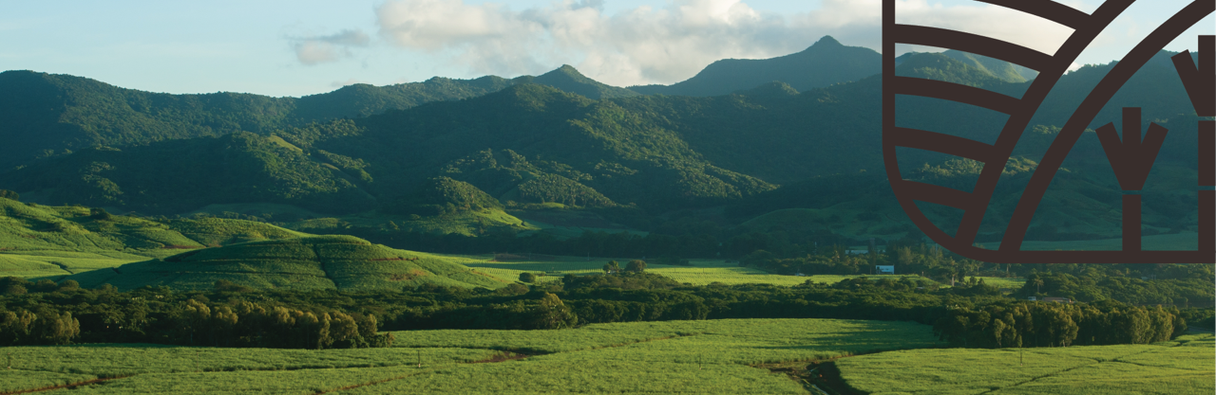
Our Commitment, our Engagement,
Our Way Foreward
MSS Sustainability Action Plan

Slide 2
Contents
Defining our Sustainable Drivers ---------- 3
Sustainability Drivers
  1. Social ----------- 8
    Focus on Human Capital ----------- 10
    CSR Projects ------------ 11
  2. Ethical ----------- 22
    Defining our vision, mission and approach relative to sugar cane planters ------------ 24
    Our FairTrade Commitment ------------ 25
    FairTrade Impact ------------ 26
  3. Environmental ----------- 33
    The Circular Economy within the industry... ------------ 35
    Key Benefits from Circular Economy ------------ 36
    Omnicane Bioethanol Distillery ------------ 37
    The Negative Carbon Footprint Commitment ------------ 40
Going Forward ----------- 44

Slide 3



DEFINING OUR SUSTAINABILITY DRIVERS
SOCIAL
ETHICAL
ENVIRONMENTAL
FOCUSED ON EDUCATING AND SUPPORTING EMPLOYEES AND LOCAL NGOS WHILE GIVING BACK TO LOCAL COMMUNITIES
Attracting and retaining employees with shared values and focused on training and development opportunities and ensuring their work environment is safe and healthy
Consistent monitoring and minimizing of the impact we have on the environment and communities where we operate

Slide 4
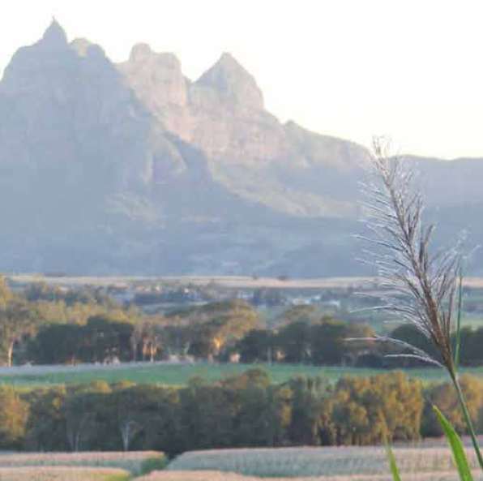
Our sustainability vision and approach
Goal 12 of the UN’s Sustainable Development Goals (SDGs) to ensure responsible production and consumption patterns.
EU Green Deal
Changing laws and regulations.
Alignment with clients’ evolving procurement strategies.
Customer loyalty shifting towards environmentally friendly products.
Product differentiation.
Embed more resilience into our supply chain through enhanced management of ethical, environmental and social issues.
Notes:
What shapes up our sustainability strategy

Slide 5










The key sustainability advancements
2009 - FairTrade
2014 - Sedex
2016 - altromercato
2010 – Global
Report Initiative
2015 - UN SDGs
2020 - Negative Carbon Footprint
2019 – Bon Sucro
2018 - VIVE
2017 – End of EU sugar quotas
2021 – Mauritius Sugar Cooperatives

Slide 6
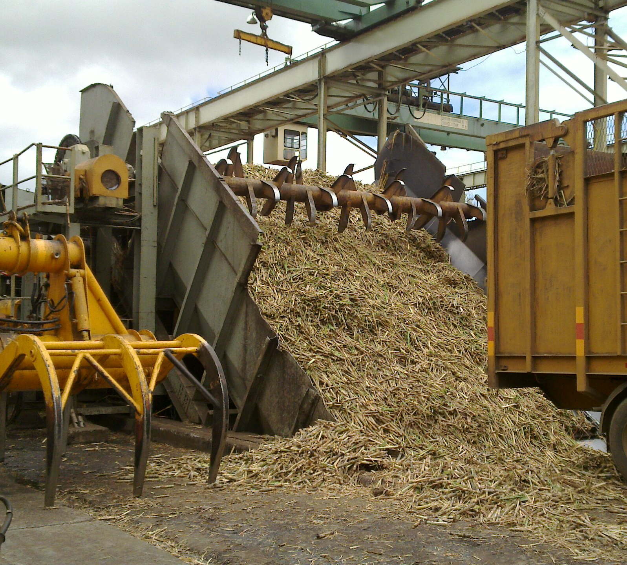

A brief look at sustainability among our 3 sugar mills
Terra
Omnicane
Alteo
All our mills are BRCGS certified and Sedex registered
All mills report on their sustainability performance using the Global Reporting Initiative (GRI) Standards.
Fairtrade co-operatives supply cane to all 3 mills.
SMETA / Sedex certified
Bonsucro certified
Bonsucro certified
Omnicane holds a VIVE accreditation

Slide 7

Why Bonsucro?
Focused on sugarcane sustainability.
Complete package of social, environmental and economic requirements.
Metrically measurable set of targets.
Universally recognized by most of our customers.
End product (Sugar/Ethanol) can be marketed and traded as BonsucroCertified.

Slide 8
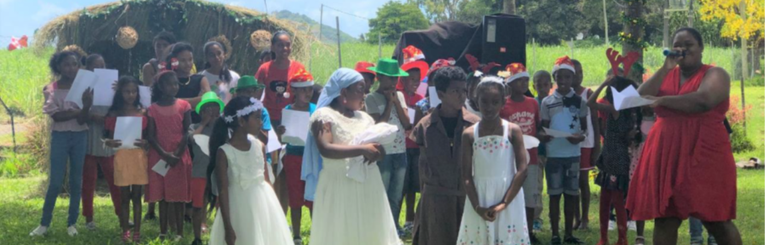
Sustainability Drivers
Social

Slide 9
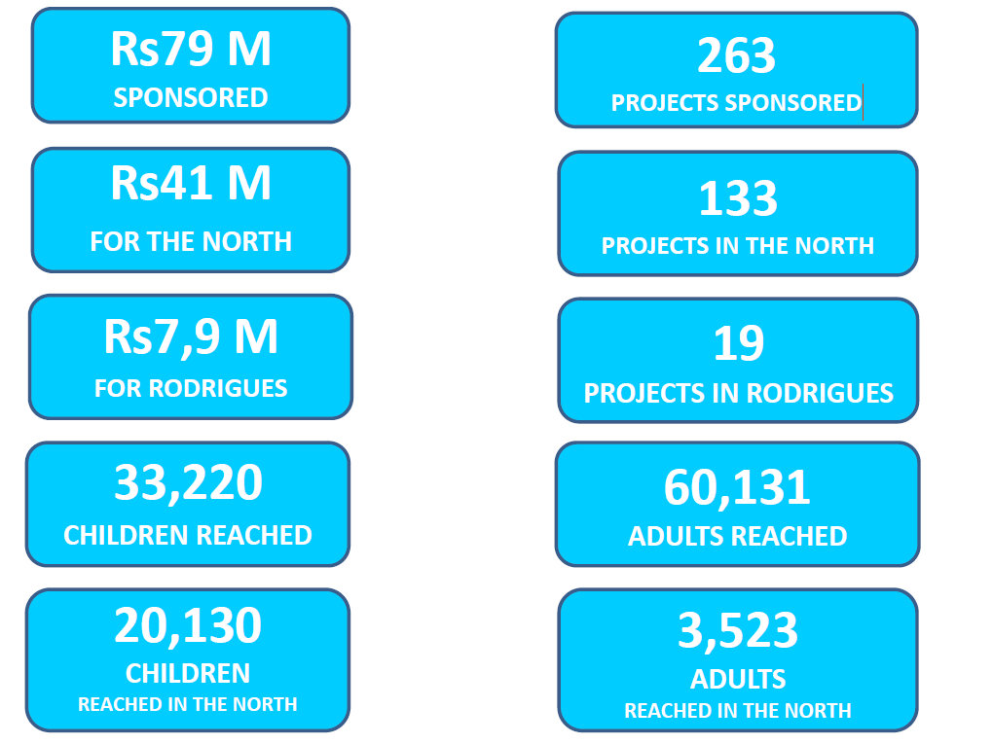
CSR Projects
In 2020, Terra Foundation maintained partnerships with 16 NGOs and sponsored a total of 32 projects. Twenty-eight of these projects, equating to 88% of our funding, were delivered in the northern region. With a budget of MUR 2.9 million (net of administrative expenses), the Foundation reached a total of 1,452 beneficiaries. Our key focus remained on education and training, poverty alleviation, health care, sports, and culture and heritage.

Slide 10
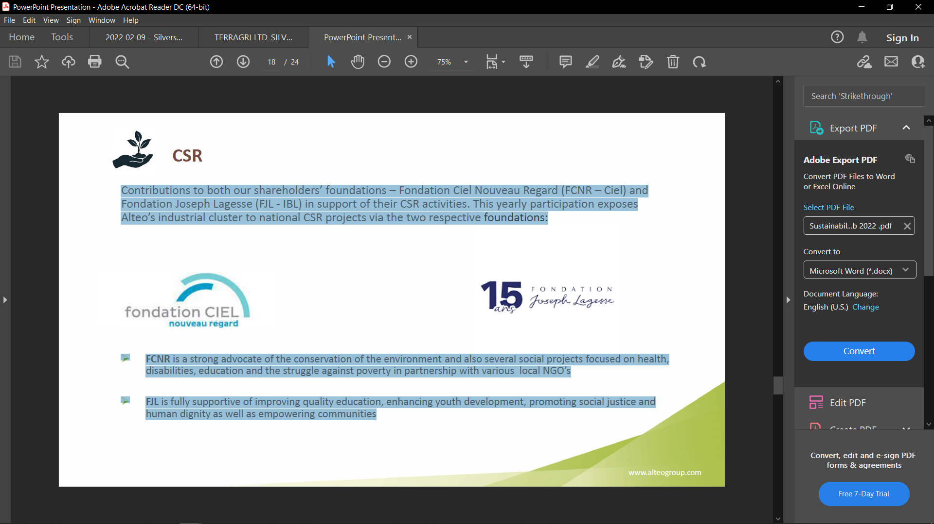
Alteo’s CSR projects
Contributions to both our shareholders’ foundations –FondationCiel Nouveau Regard (FCNR –Ciel) and FondationJoseph Lagesse (FJL -IBL) in support of their CSR activities.
This yearly participation exposes Alteo’s industrial cluster to national CSR projects via the two respective foundations:
➢FCNR is a strong advocate of the conservation of the environment and also several social projects focused on health, disabilities, education and the struggle against poverty in partnership with various local NGO’s
➢FJL is fully supportive of improving quality education, enhancing youth development, promoting social justice and human dignity as well as empowering communities

Slide 11
Alteo’s CSR incentives
Alteo’s operations and community engagement activities contribute directly and indirectly to 16 out of the 17 UN Sustainable Development Goals (SDGs).
Alteo Group talks of Corporate Social Responsibility (CSR) in Mauritius and Community Engagement in Tanzania and Kenya.
• Projects in Mauritius are mainly geared towards enhancing quality of life and working on social problems linked to the local development challenges.
• In 2019/20, total funding allocated via Alteo’s CSR budget and Anahita Centre for Excellence amounted to Rs 5,447,236 (including amount remitted to the MRA for onward contribution to the National CSR Foundation) and Rs 5,795,036, respectively.
Key activities
COVID-19 support
• 160 families in the eastern region were provided with food packs from April to June 2020, in collaboration with Rotaract of Flacq and the local authorities.
• Alteo contributed more than Rs. 4,102 M to the National COVID-19 Solidarity Fund.
• An internal solidarity fund was also set up at Alteo from voluntary salary deductions from employees, management, and board directors, and a total of Rs. 5,700 M was raised. The use of the funds will come in support to people whose financial income have been negatively impacted by the pandemic and to set up socioeconomic
Programmes
• The Skills Hub Programme, one of the flagship initiatives of Alteo, was not held due to the national lockdown.
• The Group contributed to the funding of Fondation Ciel Nouveau Regard and Fondation Joseph Lagesse, which are Ciel’s and IBL’s respective Special Purpose Vehicles tasked with implementing social projects.

Slide 12
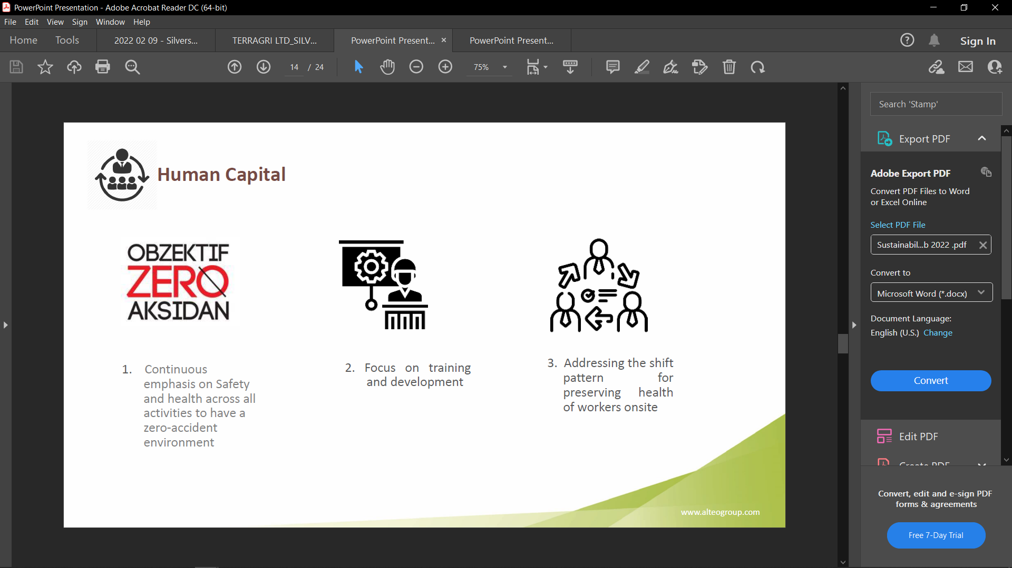
Focus on Human Capital
Continuous emphasis on Safety and health across all activities to have a zero-accident environment
Focus on training and development
Addressing the shift pattern for preserving health of workers onsite
Strong commitment towards the community
  Dedicated annual budget
  Committee in place for managing CSR projects
Main pillars of intervention: education with a focus for disabled children, environmental conservation and protection and community empowerment
Work in progress for addressing gender balance within the Industry

Slide 13
Other CSR projects involve…
Contributions have also been made in terms of gift packs during the Christmas period to 115 children associated to the two regional schools; the company supports namely APEIM and EWAD. Both these institutions provide shelter and support to handicapped children. (~Rs300,000)
The CSR committee, leans on employees volunteering to prepare give away packs for 154 impoverished people in the neighbouring communities following a successful first attempt/
An employee competition was run and the winner has received funds to direct towards a CSR project of her choice in the neighbouring villages. The funds will be spent on educational material for 30 vulnerable children.

Slide 14
Terra Milling’s social compliance plan defined by the following values:
No discrimination
Minimum wage
No forced labour
Bonuses:
productivity,
seniority,
attendance
No harsh
treatment
Safe & hygienic
workplace
No child labour
Freedom of
association &
collective
bargaining
Overtimes paid at
premium rate
Whistleblowing
Notes:
Being in the high development category, Mauritius has
a solid foundation and regulation around community
engagement. This is why the Group talks of Corporate
Social Responsibility (CSR) in Mauritius and Community
Engagement in Tanzania and Kenya.
• Projects in Mauritius are mainly geared towards
enhancing quality of life and working on social problems
linked to the local development challenges.
• In 2019/20, total funding allocated via Alteo’s CSR
budget and Anahita Centre for Excellence amounted to
Rs 5,447,236 (including amount remitted to the MRA for
onward contribution to the National CSR Foundation) and
Rs 5,795,036, respectively.

Slide 15
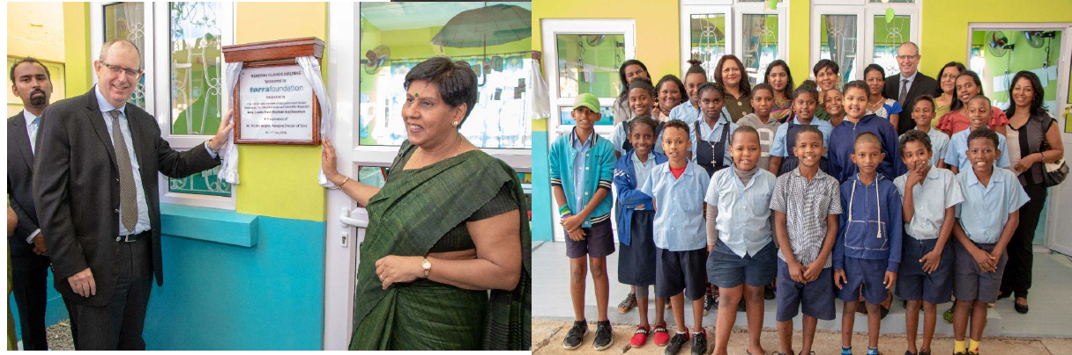
Investing in Education, Poverty Alleviation and HealthCare
1. Sponsorship of two remedial classes and other projects targeted to vulnerable students in the largest ZEP (priority education zone) school of the island which includes:
• Sponsoring vocational training for a vulnerable youth.
• Supporting visually impaired children.
• Continuing our support for an NGO that works with autistic students.
• Providing daily meal support to disabled students.
• Supporting two schools in the North in the delivery of the programme ‘Les Amis de Zippy’ that develops children’s skills in coping with emotions, difficult situations and violence.
2. Supporting the monitoring of youth falling out of the mainstream educational system and enabling integration through the Cycling Academy and a sports coach.
• Supporting the work of an NGO delivering an empowerment and monitoring programme for vulnerable children living in a pocket of poverty including daily meals, trainings and other recreational activities.
• Supporting an NGO monitoring and empowering ten vulnerable families.
3. Assisting vulnerable children and adults suffering from Type 1 diabetes with access to quality health services and sponsoring therapy activities to improve the daily management of their disease.
Inauguration of Remedial
class at H. Ramnarain

Slide 16
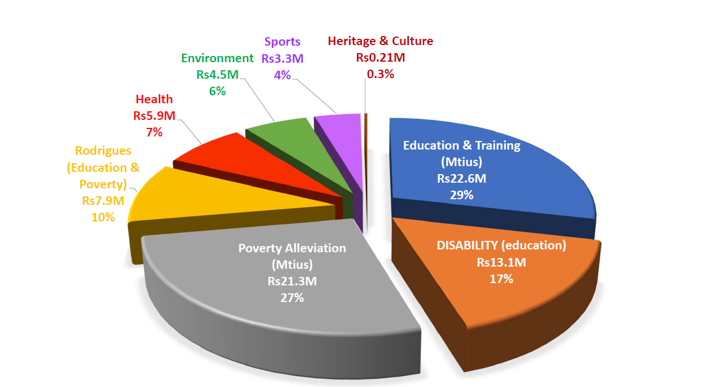
Percentage sponsorship over the past 10 years

Slide 17
Covid‐19 emergency funds & other Group supports
Stay safe operation
  Donation of masks and sanitizing solution to NGOs of the North and hands free sanitising stations to the SSR National Hospital.
Group support
  Our Common Home Project Psychological support to a family following a tragric accident
Donation of food packs
  Owing to the critical situation following the sudden lockdown in 2020, the group responded by creating a special emergency fund of Rs1,000,000 to support the neediest of the North.
  339 food packs sponsored for 5 NGOs of the North for a total of Rs 543,762.

Slide 18
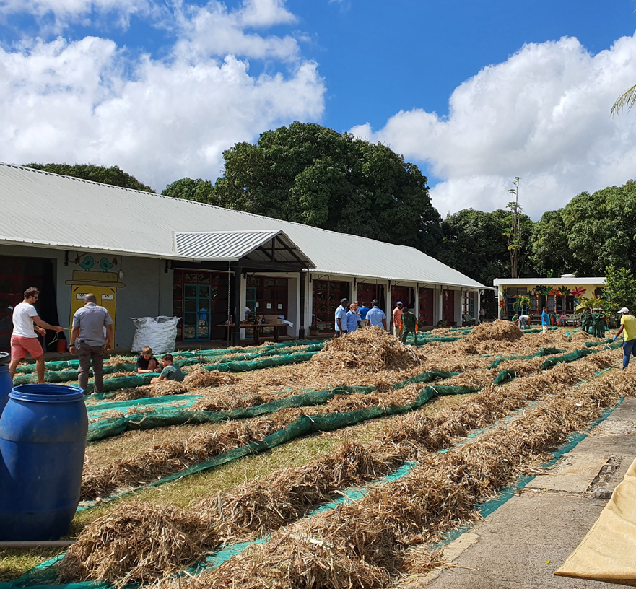
TERRA’S RAPID RESPONSE TO
THE MV WAKASHIO OIL SPILL
On the 25 July 2020, a Japanese bulk carrier vessel, the MV Wakashio, ran aground on an offshore coral reef, south of Mauritius. The ship proceeded to break apart, leaking some 1,000 tonnes of oil into the ocean Park as a home for local craft and artisans.
The Creative Park of the Beau Plan Smart City was made fully available as the base of operations. Terragen donated 32 tonnes of cane straw, complemented by nylon mesh from Attitude Hotels and sewing needles from resident artisan Patrick Mavros, to enable manufacture of the biomass booms.
Volunteers rapidly began to arrive in groups at the Creative Park, and by 10 a.m. on the first official day of operations, there were 500 people producing booms together in a diverse and spirited community production line.
Over the next seven days, more than 2,500 volunteers arrived at the Creative Park to contribute in the collective effort, enabling the manufacture of 11km of floating boom to help contain the oil spill. More than 50 companies enabled their staff to volunteer, including the Terra Group and Attitude Hotels. Volunteers arrived from local government departments, NGOs, tenants at the Creative Park and members of surrounding communities. Attitude Hotels and a host of other local companies made a massive effort to provide food and beverages to the hard-working volunteers.
The Creative Park also became a collection point for public donations of protective equipment for font-line workers at the oil spill. All donations were transported to critical areas of the spill, along with the daily dispatch of the cane straw bales.
This incredible initiative illustrates the value of local craft and underscores the tremendous power of civil society when responding in solidarity to a crisis. The collective community experience highlights the great potential for transformation when diverse people come together in a common struggle.
Terra’s stakeholder relationships are strengthened through this experience and it has injected new life into the idea of the Creative Park as a home for local craft and artisans.

Slide 19
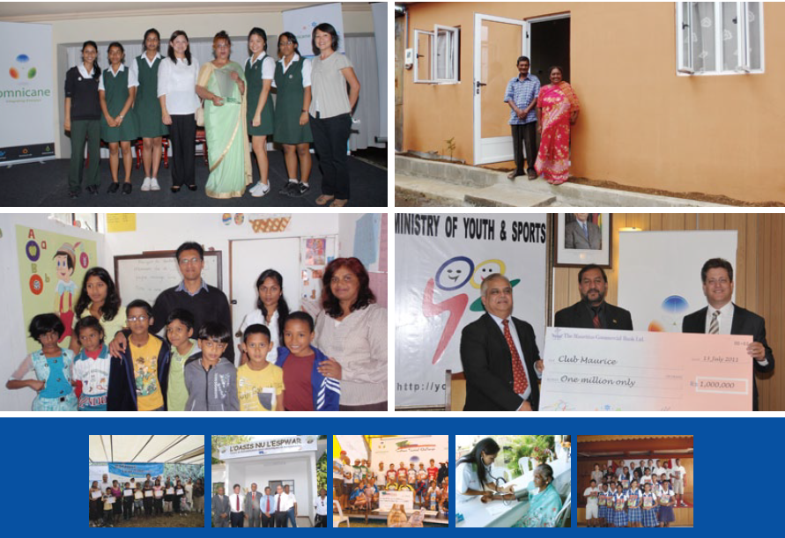
Omnicane’s CSR Incentives
To ensure better coordination and sustainability for the Group’s CSER initiatives in favour of the community, the Company created an exclusively CSER-dedicated entity, Omnicane Foundation, in October 2009. By virtue of its registration with the National Corporate Social Responsibility (CSR) Committee, the Foundation is able to initiate and implement projects pertaining to community development. These projects aim to promote human development and, in many instances, alleviate poverty, in harmony with the natural environment.
The Foundation has an internal CSER steering committee of 9 members. The committee assesses new projects and reviews progress in respect of ongoing projects. The following entities of Omnicane are represented in Omnicane Foundation:
Omnicane Milling Operations Limited
Omnicane Thermal Energy Operations (La Baraque) Limited
Omnicane Thermal Energy Operations (St Aubin) Limited
Omnicane Limited

Slide 20
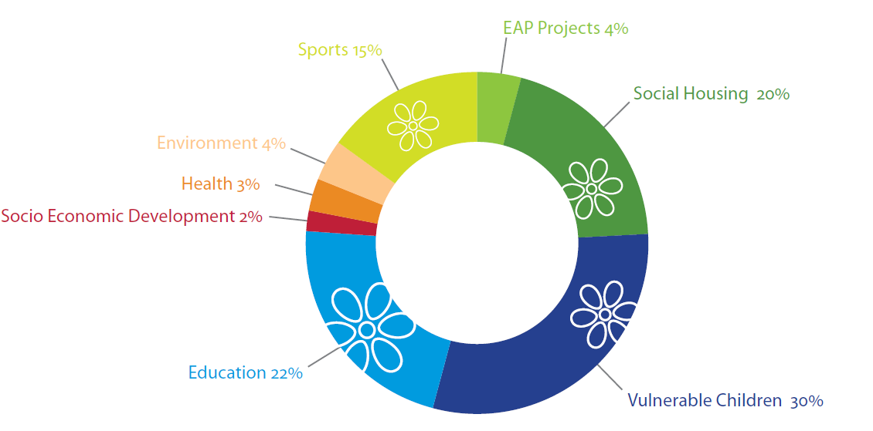
Being a responsible corporate citizen, valuing our people, engaging constructively with our local communities and actively supporting numerous local and national NGOs.
Poverty alleviation
Education
Health and well being
Sports
Environmental protection
Social housing
Eradication of absolute poverty
Vulnerable children
Prevention of non-communicable diseases

Slide 21
Main targets of Omnicane’s CSR Projects
Poverty alleviation
Social housing
Environment
Beach clean-up
Sports
Sponsoring of athletes
Health
Support to Type 1 & Type 2 diabetics NGOs
Education
Free kindergarten for vulnerable children
Women Empowerment
Egg/Backyard farming project

Slide 22

Sustainability Drivers
Ethical

Slide 23
Green Cane harvesting
was introduced to ensure better quality of sugar products while ensuring optimal regeneration of sugar cane plants while minimizing impact on the environment
Non-GMO sugar cane and quality products
Non-GMO sugar cane plants as we rely on natural conditions to produce the safest quality products.
FairTrade
Commitment to Fair Trade label to ensure fairness of business relative to local sugar planters.

Slide 24
Defining our vision, mission and approach relative to sugar cane planters
Mission
To promote a stable and sustainable supply of sugarcane by planters to ensure the smooth and efficient operation of our 3 sugar mills.
Vision
To be a leader in the provision of agricultural services and trusted as an efficient and reliable partner of sugarcane planters.
Approach
To operate as a one stop shop for sugarcane planters by providing them with integrated services at financially sustainable costs.
To enable planters to take advantage of technological advances through the provision of technical and agronomic advice.
To facilitate liaison and communication between planters and other stakeholders

Slide 25

Our FairTrade commitment
In a nutshell
26 Co-operatives (20 certified, 6 to be recertified)
1 Federation of Fairtrade Co-operatives
1 certified Trader / Payer (Mauritius Sugar Syndicate)
About 4,500 sugar cane planters (about 40% of the island’s
planters)
About 20,000 tonnes of certified sugar (6% of total national production)
More than Rs 500 million received as Premium since 2009
Harnessing additional financial resources to the benefit of more vulnerable farmers (21 coops, 3,000 planters)
MSS is the certified Trader / Conveyor. Mauritius - Fairtrade sugar bestseller; 95% uptake vs. 30% globally
Proven sustainability instrument; Fairtrade Premium drives change – Impact Study
Close collaboration with Fairtrade International
Certification volatility hampering our FT sugar availability

Slide 26
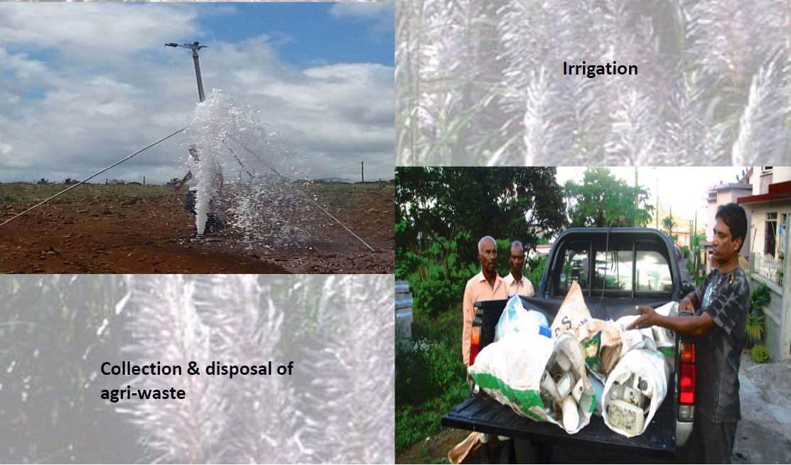
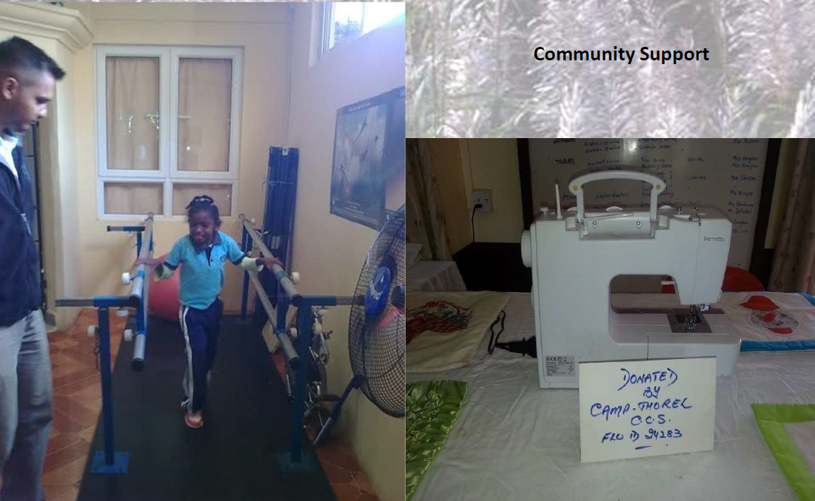
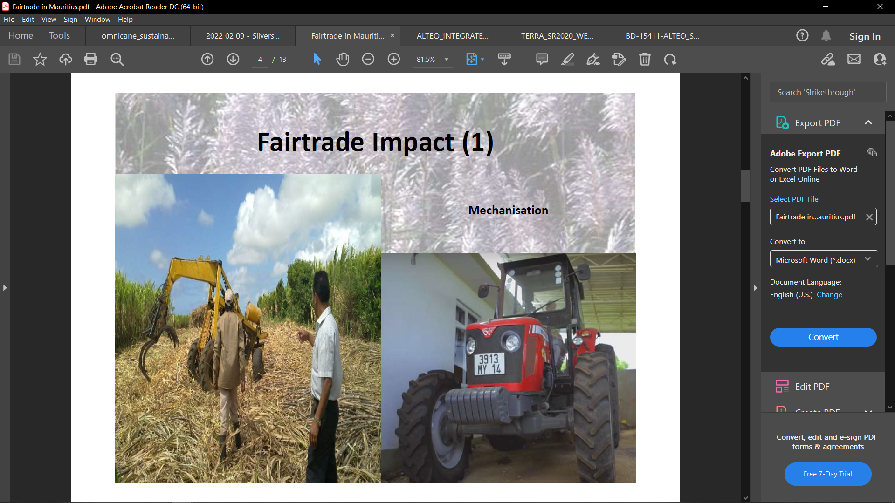
FairTrade Impact

Slide 27
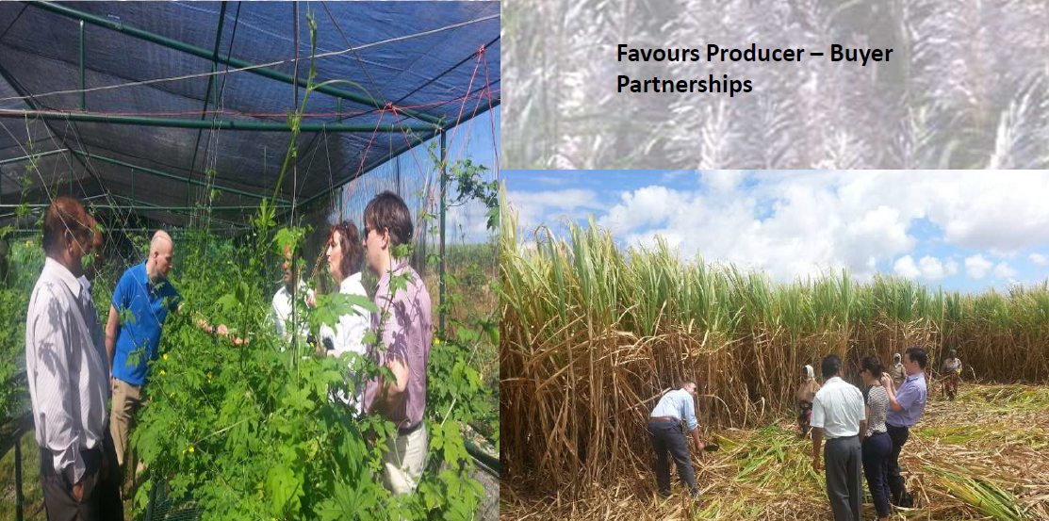
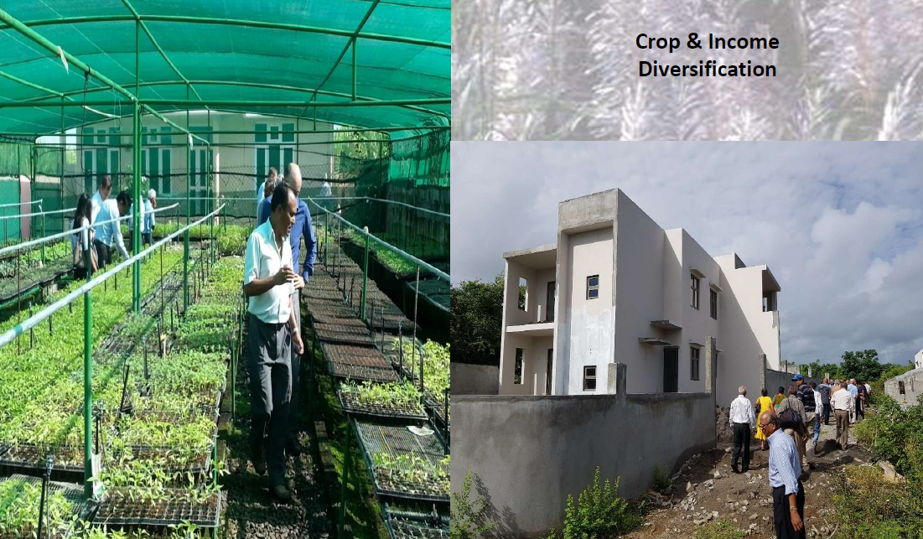
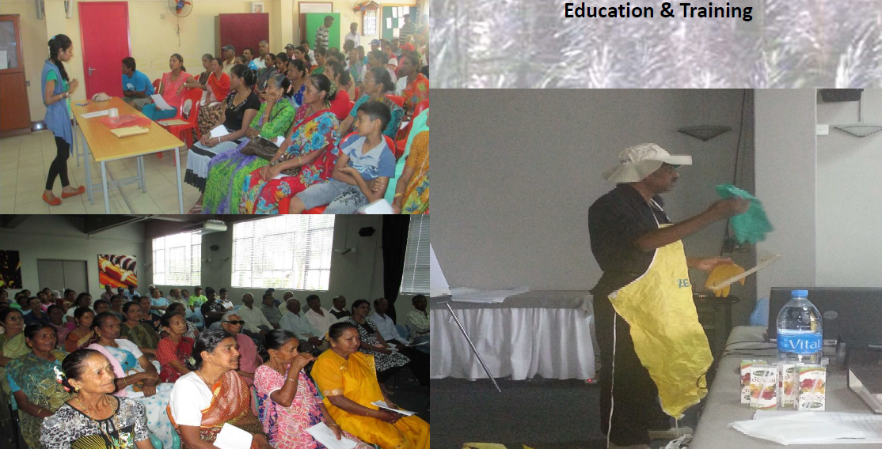
FairTrade Impact

Slide 28
Omnicane Milling’s initiatives to support local planters
Setting up of Planters Advisory Department by Omnicane Milling in 2015
Challenge: tackle the issue of field abandonment and reduced productivity from small planters.
Objective: Provide total management service to small planters.
Key Figures:
Total Acreage under our supervision:
318 arpents = 8,840 tonnes of cane
Total Management:72 planters
Plantation, Maintenance of fields (manual and chemical weeding, fertilisation etc.) ,Harvest,Loading & Transport of canes
Partial Management:6 Planters
Harvest, Loading & Transport of canes to the Factory

Slide 29
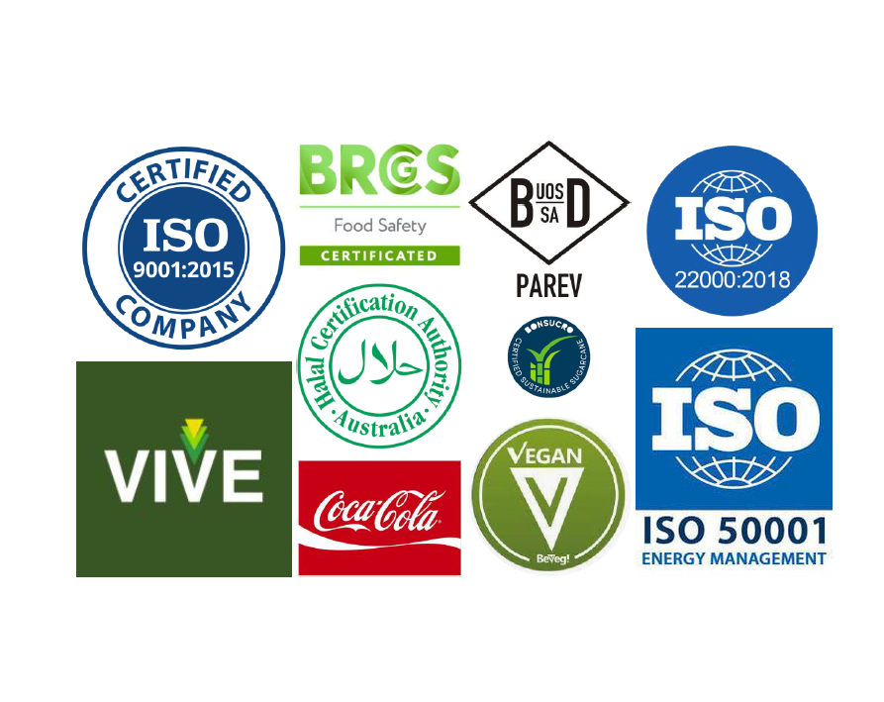
Omnicane’s Refinery Quality & Food Safety for example
Well established Q&FS management system since 2010
  Monthly HACCP meetings
  Annual Management review of Key Performance Indicators (KPIs)
Quality Control and HACCP plan based on Risk Assessment
  Dedicated and well-trained HACCP Team
  Support from external consultancy
Strong Quality and Food Safety Culture
Quality and Food Safety Controls in place
  •No food and drink policy
  •No wood and glass policy
  •Non-allergen policy
  •No smoking zone
Laboratory Testing, Calibration and Weight Control

Slide 30
Reliable access control and food defense
Fingerprint access
CCTV Cameras
24h security control
Visitors control
Cyber security
Robustfull traceability system
Inspection of each empty container prior to loading
Full traceability details including SEAL NUMBERS and CONTAINER NUMBERS
Daily, full logistics data report

Slide 31
Alteo Milling’s management of input parameters for example
100% green cane harvesting policy, no more burning of sugar cane fields resulting in:
  Improved biomass, organic matters enriching our soils
  Reduced herbicide treatments
  Reduced erosion
  Full trash blanketing through green mechanical harvesting for soil protection.
Precision agriculture in cane growing resulting in 20% increase in equipment productivity and reduction of cane stool damage.
Burying of fertilizers, resulting in:
  Elimination of nitrogen losses by volatilisation
  Elimination of run-off to streams/rivers/lagoon
  Improved cane yields
Adoption of the Bonsucro threshold for herbicide application (< 5 kg of active ingredient per hectare of land) to minimise air, water and soil contamination
Exploring regenerative agricultural practices for improving soil health and potential of carbon offsetting.
Alteo Agri Ltd(3,000 ha of Beau Champ Section Area) is Bonsucrocertified

Slide 32

Sustainability Drivers
Environmental

Slide 33


ENERGY MANAGEMENT
Alteo operates a 41 MW biomass/coal power plant
Supplies steam and electricity to Alteo Milling Ltd and exports an annual average of 170 GWh to the national grid.
59.2% of the total electricity produced in Mauritius was generated by Independent Power Producers among which the Alteo Milling.
WASTE REDUCTION – REUSE & RECYCLING
Bagasse is used for renewable energy production
Molasses are exported to produce alcohol and renewable fertilisers or are processed into animal feed
Filter mud is re-injected into our fields and represents a valuable source of nutrients for both the soil and the sugarcane
Cane trash is used for pest control and weed control and could potentially be a source of renewable energy
The bottom ashes from bagasse burning are applied to fields as nutrient supplements
AIR EMISSION
Constantly monitors and controls the primary air pollutants emanating from our industrial sites.
We comply with the environmental regulations and norms applicable in each of the countries in which we operate.

Slide 34
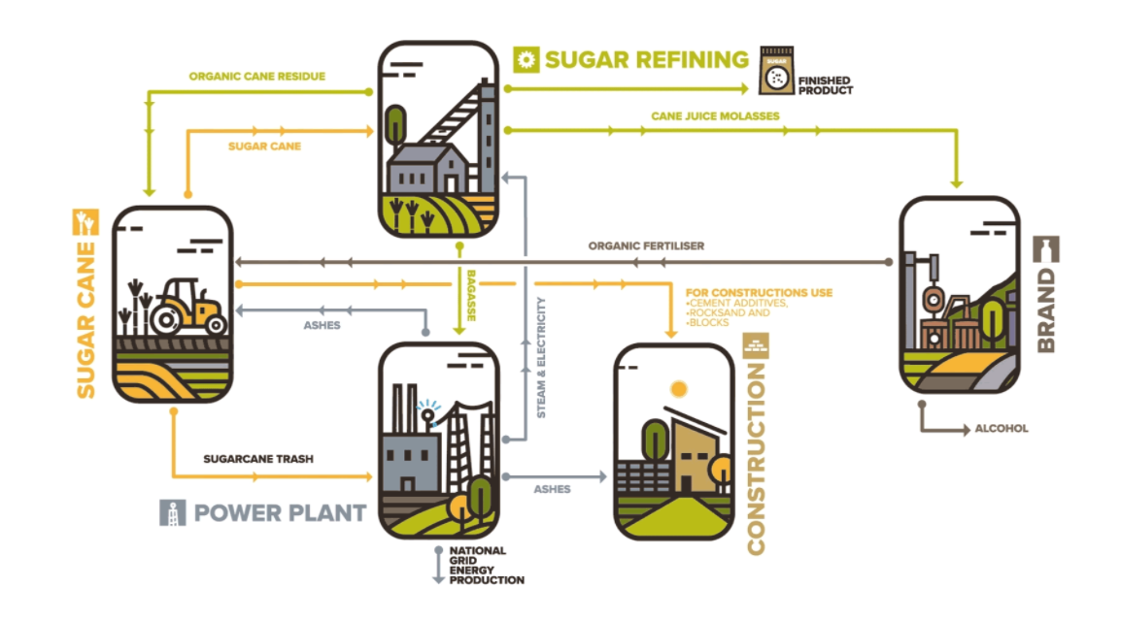
THE CIRCULAR ECONOMY WITHIN THE INDUSTRY…

Slide 35
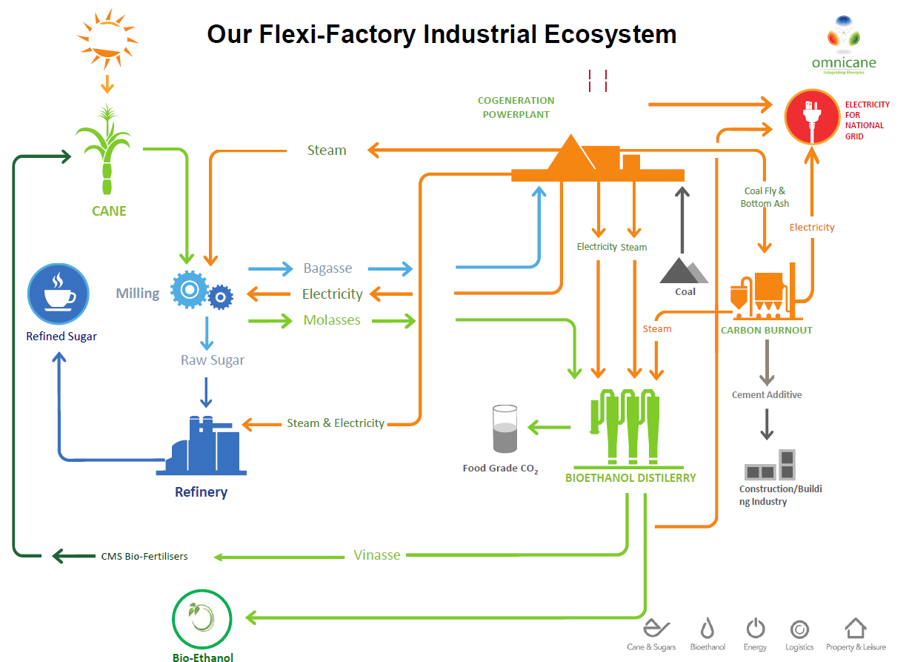
Key Benefits from Circular Economy
Reduced cost of production through less wastage and more efficient use of resources.
1 tonne of sugar produces 1.1 MWh of renewable electricity
Develop new products and attract new customers.
Build loyalty with customers.
Exceed Government Regulations and stay ahead of new requirements.
Reinforce brand and reputation as an innovative organisation.
Attract, retain and engage employees.

Slide 36
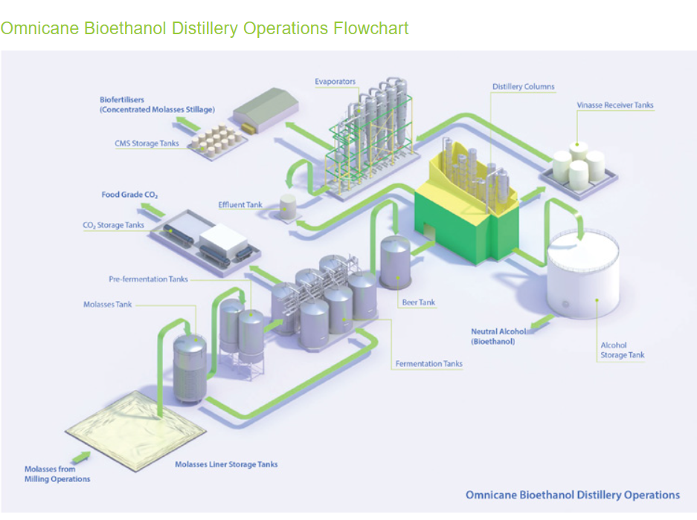
Omnicane Bioethanol Distillery
The Omnicane bioethanol distillery can produce up to 24 million litres of bioethanol annually
used in pharmaceutical and industrial products as well as a source of biofuel in transportation and power production
The distillery’s by-products of raw gas and concentrated molasses stillage are then further transformed to produce food grade carbon dioxide and liquid fertilisers respectively.

Slide 37
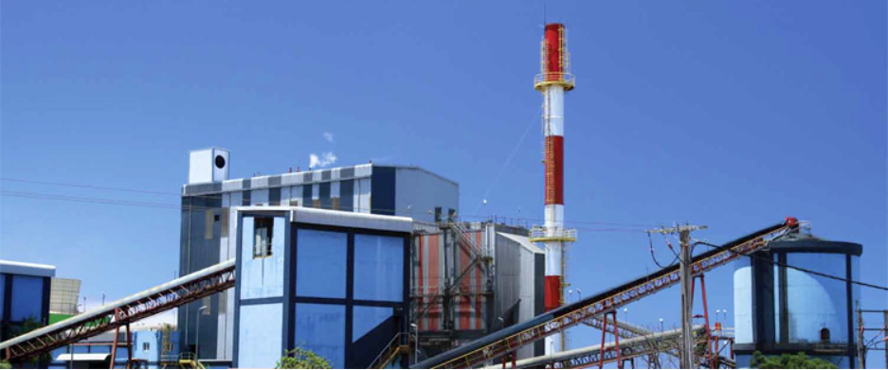
The power plant at St Aubin produces electricity for the national grid. This coal-fired thermal plant is equipped with a condensing-type turbine and is in operation since 200
WASTE REDUCTION – REUSE & RECYCLING
Electricity is produced by using bagasse during the cane harvest season from July to December, and coal during the intercrop season at Terragen.
Terragen meets several international standards and is the first Mauritian firm who has been granted, by Association Française de Normalisation (AFNOR) an integrated management system certificate based on internationally recognised standards.
Our main power plant at La Baraque is one of the largest bagasse- and coal-fired cogeneration plants in the world.
It uses bagasse during the sugarcane crop period, and coal outside of the crop period to generate steam and electricity for the cluster and electricity for the national grid. Of the same type as the first but smaller, our second power plant at La Baraque uses woodchips and coal and caters mainly for the distillery’s requirements in both steam and electricity.

Slide 38
IN NUMBERS
Alteo Milling Power Plant
205
3
1
GWh to the grid in Mauritius and Tanzania in 2021
Power plants in Mauritius and Tanzania
Solar Energy Farm
TerraGen PowerPlant by Terra Sugar Mill
450 GWh
376
GWh
4171
Capacity
produced
Tonnes of cane trash used

Slide 39
THE NEGATIVE CARBON FOOTPRINT COMMITMENT
At a time when most companies are struggling to achieve carbon neutrality, we pride ourselves on having a competitive carbon footprint of only 0.36 kg CO2e per kg sugar from farm to port. This comes down to - 0.17 kg CO2e per kg sugar if the additional emission reduction by displacement of grid electricity due to renewable energy generated from bagasse is accounted for.
Australia CFP : > 0.50 kg
Thailand : 0.55 kg
Mexico : 0.63 kg
    Carbon Burn Out Project – Out of 70,000 tonnes of residues (coal fly ash and bottom ash) collected annually from the 3 power plants, Omnicane’s carbon burn out generates 42,000 tonnes for production of cement additives, 18,000 tonnes for th production of construction aggregates and 10000tonnes for the production of steam for their cluster.
Notes:
We have a dedicated team of employees who work together to guarantee adequate field planning, land preparation and sustainable planting techniques.
We have adopted good agricultural practices in our operations such as the implementation of effective drainage systems, planting the best cane varieties according to the recommendations of the Mauritius Sugar Industry Research Institute (MSIRI), and the adoption of the principles of Integrated Pest Management. Management of sugarcane diseases and pests relies essentially on biological control, cultural practices, sound sanitation, use of disease-free planting material and the judicious utilization of agrochemicals. We also aim to devise weed management strategies to reduce the use of herbicides, and adopt appropriate trash management practices to improve soil fertility and manage pests and erosion.

Slide 40
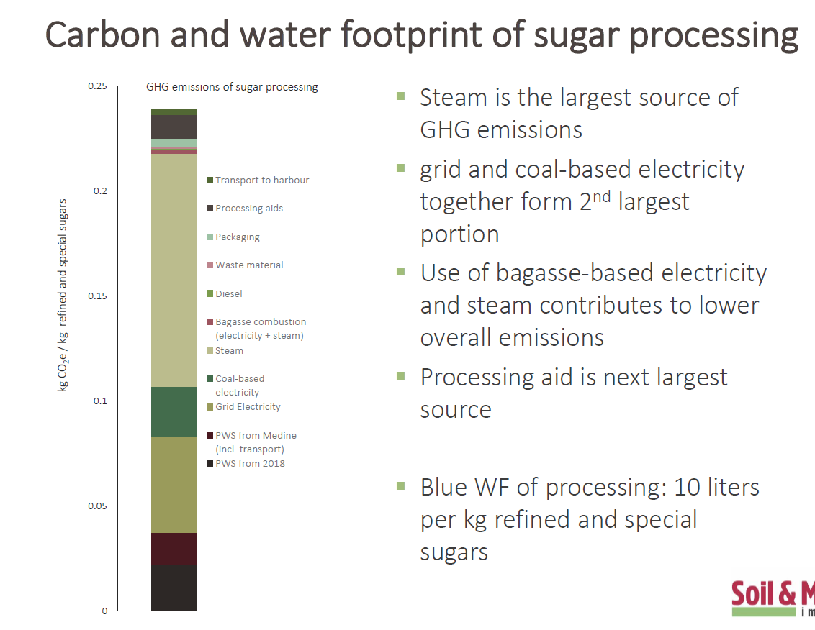

Slide 41
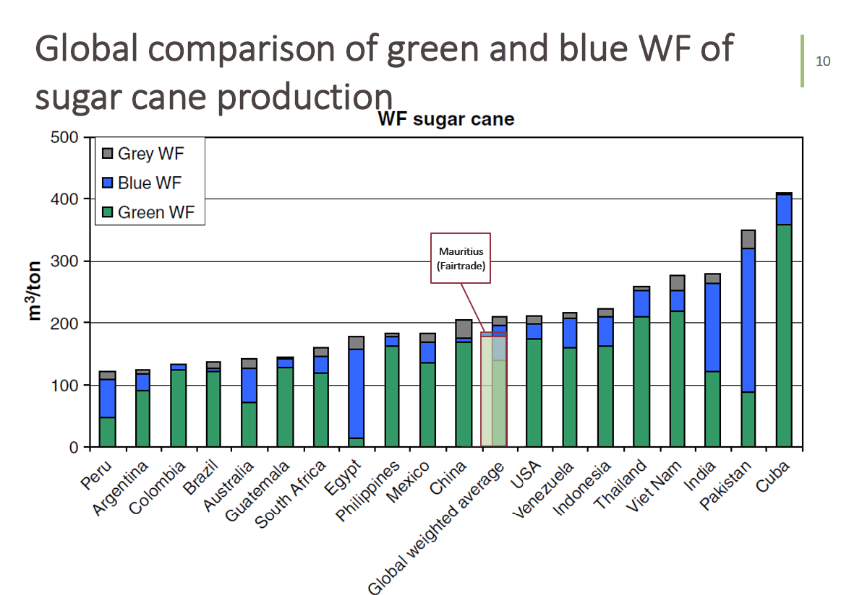
Water
Footprint
Performance
WATER USAGE BEST PRACTICES
  REUSE & RECYCLING – re-use of treated wastewater for irrigation, agricultural and industrial purposes.

Slide 42
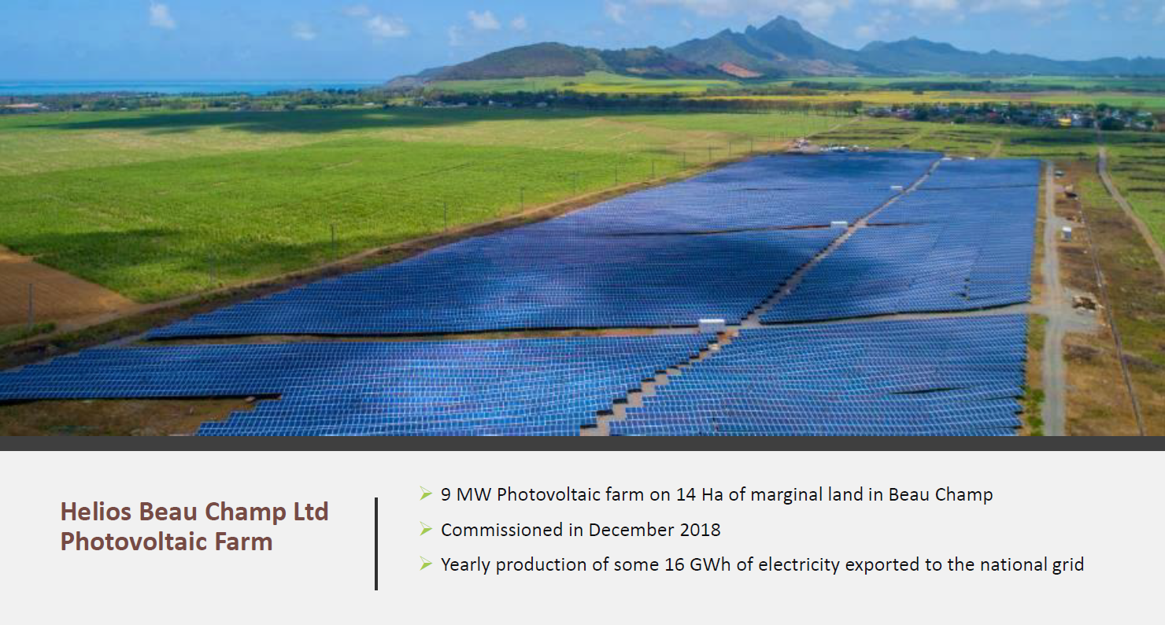

Slide 43
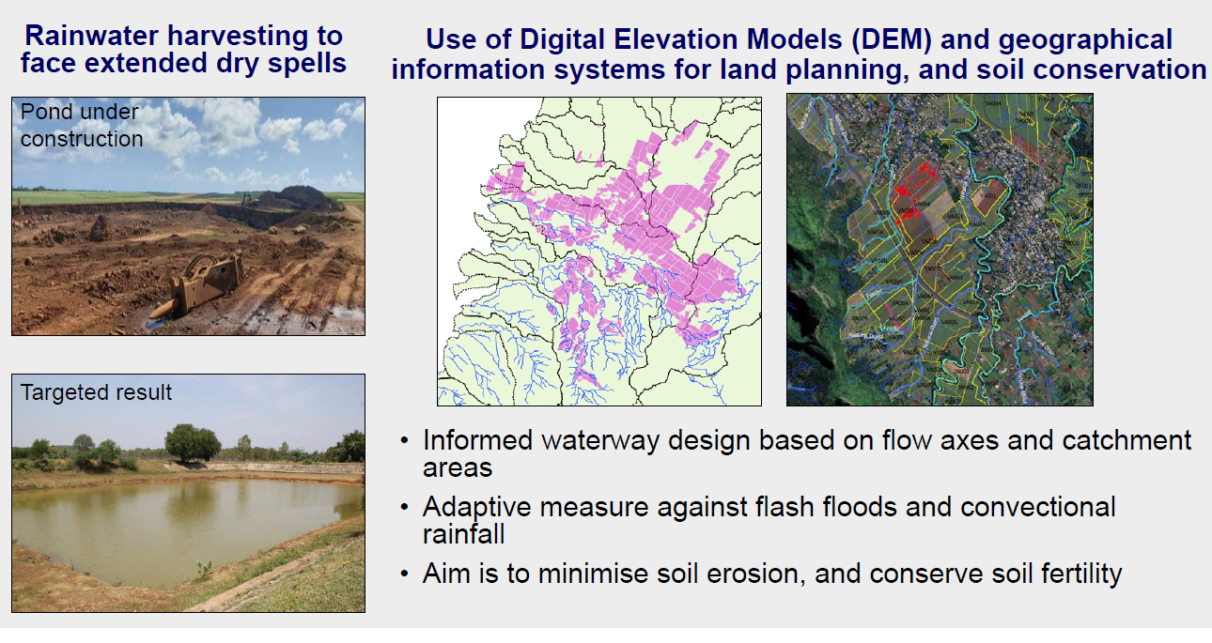
Adapting our practices to resist climate change

Slide 44

Going Forward
Certification to leading VSS’s
Step up R&D
Go organic
Measure and Reduce environmental and social impacts
Highlight our achievements
Consolidate partnerships
Celebrate people

Slide 45
THANK YOU FOR YOUR ATTENTION.

