Slide 1
MSS Club
Official Launch

Slide 2
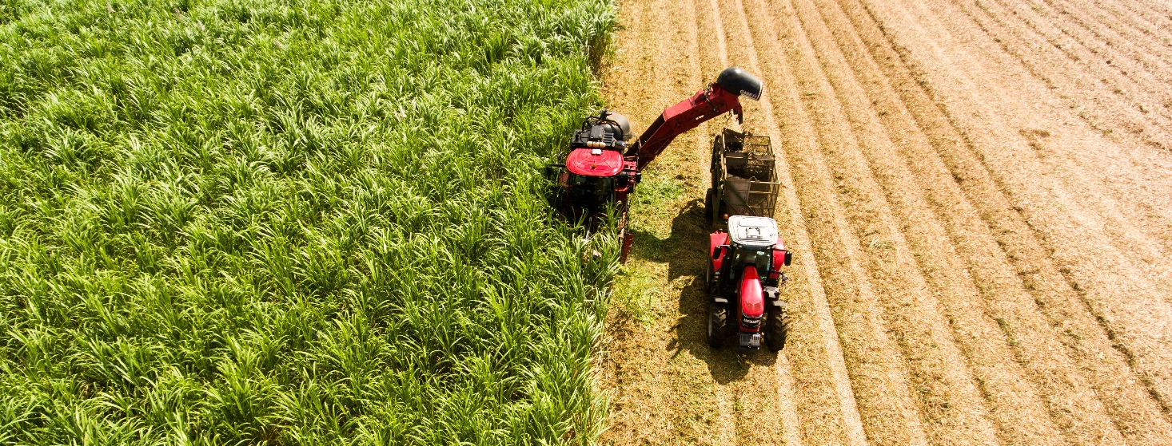
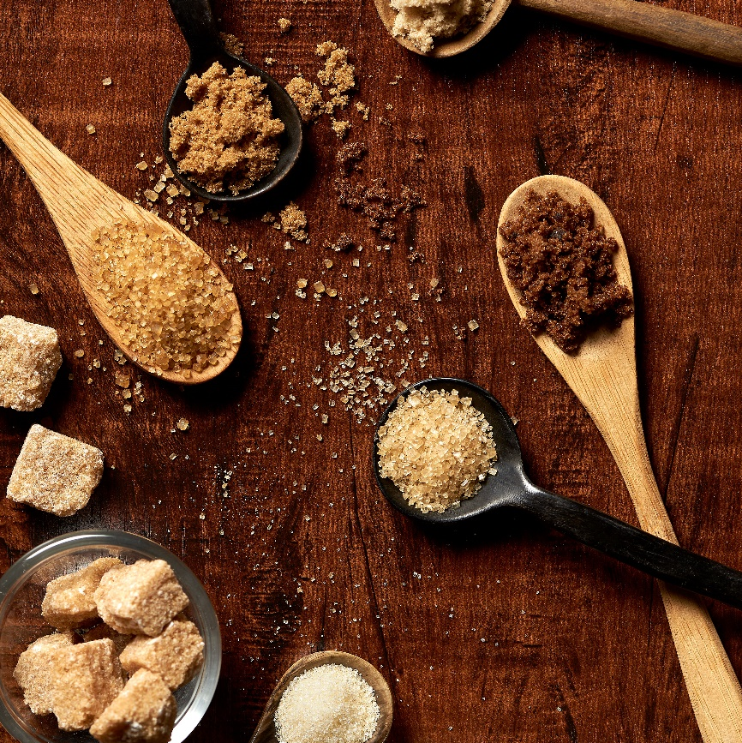



OBJECTIVES OF THE MSS CLUB
Create a platform of exchange and interaction
Sustain the long-lasting relationship with our partners
Support our partners in developing and increasing their sales
Enhance our Customers’ Responsible Sourcing Vision

Slide 3
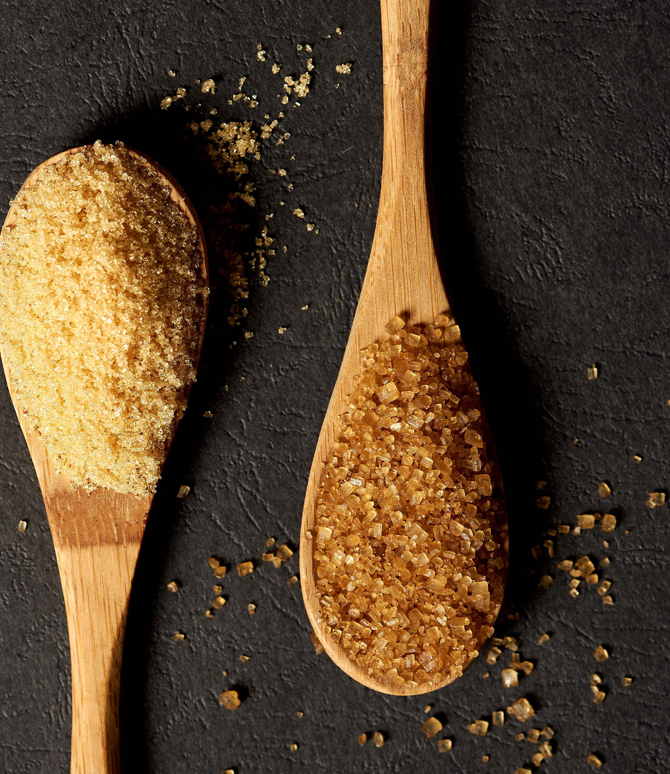

BECOMING A MEMBER
The membership package is designed to bring real benefits to you and your company and likewise to the Mauritius Sugar Community.
Any existing and potential customer willing to partner with the MSS and sharing a common vision in enhancing our brand value and sales

Slide 4
MEMBERSHIP BENEFITS
COMMERCIAL SUPPORT
Product Trials for Industrial users for existing and new SKUs
Innovation and market driven with New Product Launch
Approach new market segments (Catering / Pastry/ Bakery / Gourmet)
Reward System for your best customers
1
Support in growing your market and customer base
Help in exploring new business development opportunities
Encourage you to visit Mauritius or reward your best customers
Specific usages for each variety of Special Sugar
Support from an ambassador (Chef in relevant market segment: Bakery / Pastry / Confectionery…etc)
Value-Added service to customers: Product Knowledge and application
Dedicated marketing budget for Special Sugars
2
MARKETING SUPPORT
Know how to market Mauritius Special Sugars
Support in your branding and/or those of your customers
3
RESPONSIBLE SOURCING SUPPORT
Associate your business / brand with Mauritius Origin
Create sustainable story-telling for end-users / industrials / HORECA
Enhance your Responsible Sourcing
4
SOCIAL EVENTS
Sharing of knowledge and experience
Reward customers
Network with fellow Club Members

Slide 5
2022 PRE-LAUNCH PROGRAM
November
  Webinar on “The Historical Journey across Centuries of Sugar Cane in Mauritius”
  by Dr. Jean Claude AUTREY
December
  “Christmas Recipes” using Mauritius Special Sugars
  by Chef Philippe BERTRAND
  “Family” E-Masterclass with focus on a recipe for Kids
    by Chef Philippe BERTRAND

Slide 6



